Slide 1
Understanding trauma
Judge David Nuffer and Judge Clark Waddoups
Boyce Seminar, October 16, 2019

Slide 2
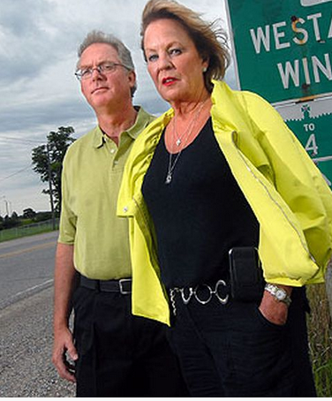
Stan and ute Lawrence Sept. 3, 1999
https://www.cbc.ca/natureofthings/episodes/ptsd-beyond-trauma
https://windsorstar.com/news/15-years-after-401-crash-trauma-remains

Slide 3
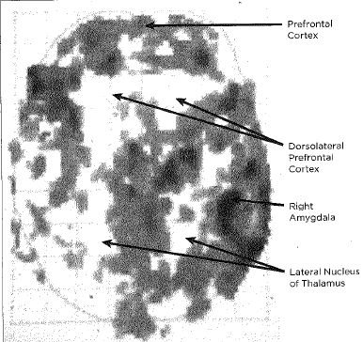
Stan’s Scan

Slide 4
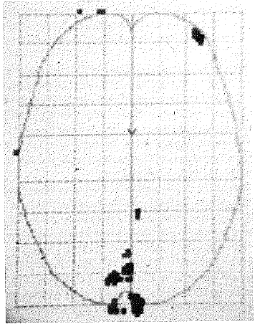
Ute’s scan

Slide 5
Normal versus PTSD. Patterns of attention. Milliseconds after the brain is presented with input it starts organizing the meaning of the incoming information. Normally, all regions of the brain collaborate in a synchronized pattern (left), while the brainwaves in PTSD are less well coordinated; the brain has trouble filtering out irrelevant information and has problems attending to the stimulus at hand.

Slide 6
CAUSES OF TRAUMA
Domestic violence | Natural disasters | Moving
Witness deposition | Serious illness | Sexual assault
Divorce | War | Prison stay
Death of family member, lover, friend, teacher, or pet | Physical pain or injury (e.g. severe car accident) | Parental abandonment

Slide 7
Play video at https://www.youtube.com/watch?v=4-tcKYx24aA

Slide 8
THE BODY KEEPS THE SCORE: brain, mind, and body in the healing of trauma Bessel Van Der Kolk, M.D.
“Trauma is much more than a story about something that happened long ago. The emotions and physical sensations that were imprinted during the trauma are experienced not as memories but as disruptive physical reactions in the present.”
p. 206

Slide 9
Effects of trauma
Hypervigilance
Numbing
Loss of speech
Memory blocks
Depersonalization, dissociation, loss of self, split personality
Inability to choose, control, flee
Inability to maintain healthy relationships
Addiction to trauma, drugs, work

Slide 10
How do you turn a newborn baby with all its promise and infinite capacities into a thirty-year-old homeless drunk?
THE BODY KEEPS THE SCORE:
brain, mind, and body in the healing of trauma, p. 145 Bessel Van Der Kolk, M.D

Slide 11
ADVERSE CHILDHOOD EXPERIENCES (ACE) STUDY
“Did a parent or other adult in the household often or very often swear at you, insult you, or put you down?”
1 in 10 answered “yes”
“Did one of your parents often or very often push, grab, slap, or throw something at you?”
1 in 4 answered “yes”
“Did one of your parents often or very often hit you so hard that you had marks or were injured?”
1 in 4 answered “yes”

Slide 12
ADVERSE CHILDHOOD EXPERIENCES (ACE) STUDY, Con’t.
“Did an adult or person at least 5 years older ever have you touch their body in a sexual way? Or Did an adult or person at least 5 years older ever attempt oral, anal, or vaginal intercourse with you?”
28% of women answered “Yes”
16% of men answered “Yes”
“As a child, did you witness your mother sometimes, often, or very often pushed, grabbed, slapped, or had something thrown at her? Or as a child, did you witness your mother sometimes, often, or very often kicked, bitten, hit with a fist, or hit with something hard?”
1 in 8 answered “yes”

Slide 13
“Traumatic experiences are often lost in time and concealed by shame, secrecy, and social taboo, but the [ACE] study revealed that the impact of trauma pervaded these patients’ adult lives.”
ACE scores of 4 or higher:
Learning and behavioral problems
Higher workplace absenteeism, financial problems, lower life-time income
Chronic depression (66% in women, 35% in men)
Taking antidepressants or prescription painkillers
Self-reported suicide attempts
ACE scores of 6 or higher:
Seven times more likely to be alcoholic
4,600% greater likelihood of IV drug use
p. 148

Slide 14
Trauma breeds further trauma; hurt people hurt other people.
THE BODY KEEPS THE SCORE:
brain, mind, and body in the healing of trauma, p. 350 Bessel Van Der Kolk, M.D

Slide 15
THE BODY KEEPS THE SCORE: brain, mind, and body in the healing of trauma Bessel Van Der Kolk, M.D.
“Being able to feel safe with other people is probably the single most important aspect of mental health; safe connections are fundamental to meaningful and satisfying lives.”
p. 81

Slide 16
“Social support is not the same as merely being in the presence of others. The critical issue is reciprocity: being truly heard and seen by the people around us, feeling that we are held in someone else’s mind and heart.”
ADDRESSING TRAUMA REQUIRES HUMAN CONNECTION
THE BODY KEEPS THE SCORE:
brain, mind, and body in the healing of trauma, p. 81 Bessel Van Der Kolk, M.D.

Slide 17
Recovery – rewiring the mind and body
Yoga, Tai Chi, Qigong
Mindfulness
Neurofeedback
Guided restructuring
EMDR
Theatre
Dance

Slide 18
Practical implications for lawyers
Preparing/interviewing witnesses
Assessing client’s truthfulness
Advising client on how to proceed in case
Jury selection
Presenting a case to the jury
CRIMINAL CASE IMPLICATIONS: Decisions about pleading guilty, sentencing issues, conditions for supervised release
Treating your own practice-related trauma

Slide 19
Beneath the surface of the protective parts of trauma survivors there exists an undamaged essence, a Self that is confident, curious, and calm, a Self that has been sheltered from destruction by the various protectors that have emerged in their efforts to ensure survival. Once those protectors trust that it is safe to separate, the Self will spontaneously emerge, and the parts can be enlisted in the healing process.
THE BODY KEEPS THE SCORE:
brain, mind, and body in the healing of trauma Bessel Van Der Kolk, M.D.

Slide 20
Understanding trauma
Judge David Nuffer and Judge Clark Waddoups
Boyce Seminar, October 16, 2019

