Slide 1

Avoiding Pitfalls in
Written Advocacy
David Nuffer
November 2014

Slide 2
Be understood,
then be persuasive.
Notes:
Too often we jump to persuasion before being sure we are understood.

Slide 3
Be understood.
Be persuasive.
The Basics
Start to Craft
Avoid the Sirens
Artistry
Notes:
We have four segments of the presentation. Basics, which are elementary. The process of starting to create a powerful writing. Avoiding distractive practices. And making the writing a work of art that is a pleasure to read.

Slide 4
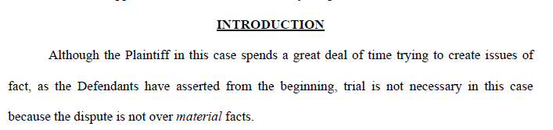
Computec disputes facts which are not material.
Notes:
In this case
Introduction – first sentence
“as the Defendants have asserted” - assumes something I have long forgotten
Re write this.

Slide 5
The Basics
Start Early
Spell Check
Grammar Check
Proofread
  Read aloud
  Read from back
  Read in paper form
  How many words can be eliminated?

Slide 6
The Basics (continued)
Apply the proper standards
  Standards of review
  Comply with DUCivR 56
  Never assume jurisdiction exists
Every case has a plaintiff and defendant; what are the roles or names in this case?

Slide 7
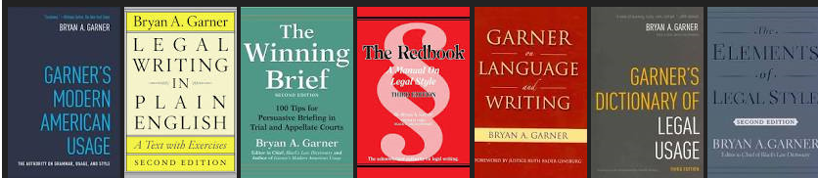
Starting to Craft
Outline
  Think about the organization
  Reflect the outline in format – headings, previews, summaries
Focus on what matters – remove weak arguments and the irrelevant
Do everything Bryan Garner says
  Language use
  Inline citations
  Speaking footnotes

Slide 8
Garner’s Usage Tip of the Day
January 1, 2010
obviously, like other dogmatic words ("clearly," "undeniably," "undoubtedly"), is one that writers tend to rely on when they're dealing with difficult, doubtful propositions. Be wary of it.

Slide 9
Garner’s Usage Tip of the Day
November 23, 2009
Officialese is the language of officialdom, characterized by bureaucratic turgidity and insubstantial fustian; inflated language that could be readily translated into simpler terms.
Officialese is governed by four essential rules.
First, use as many words as possible.
Second, if a longer word (e.g.,"utilize") and a shorter word (e.g., "use") are both available, choose the longer.
Third, use circumlocutions whenever possible.
Fourth, use cumbersome connectives when possible ("as to," "with regard to," "in connection with," "in the event of," etc.).
Notes:
Fustian - pompous or pretentious speech or writing.
Circumlocution - the use of many words where fewer would do, especially in a deliberate attempt to be vague or evasive.

Slide 10
Among the linguistically unsophisticated, puffed-up language seems more impressive.
Thus, police officers never "get out of their cars"; instead, they "exit their vehicles."
They never "smell" anything; rather, they "detect it by inhalation."
They "proceed" to a "residence" and "observe" the suspect "partaking of food."
And among lawyers, rather than "suing," one "institutes legal proceedings against" or "brings an action against."
Notes:
People who use jargon are either ignorant of their subject and pretentious, or lying.

Slide 11
See pages 7A and 7B of the materials

Slide 12
See page 7C of the materials

Slide 13
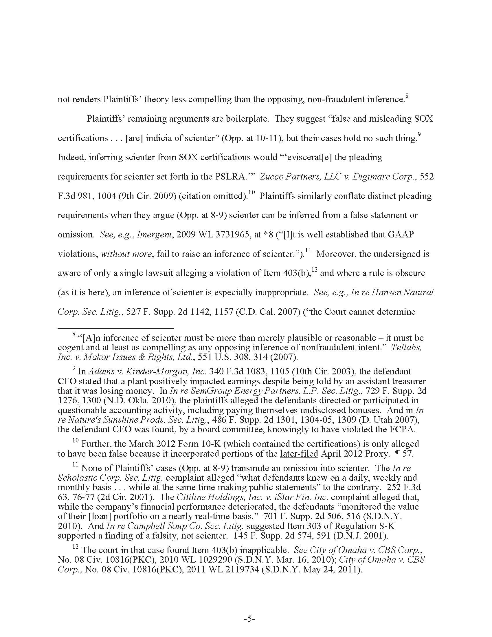
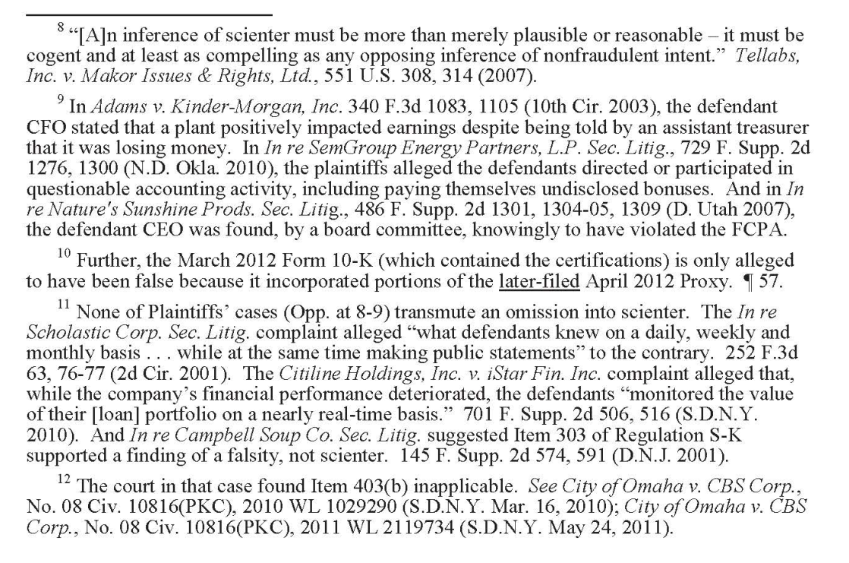
See page 8 of the materials

Slide 14
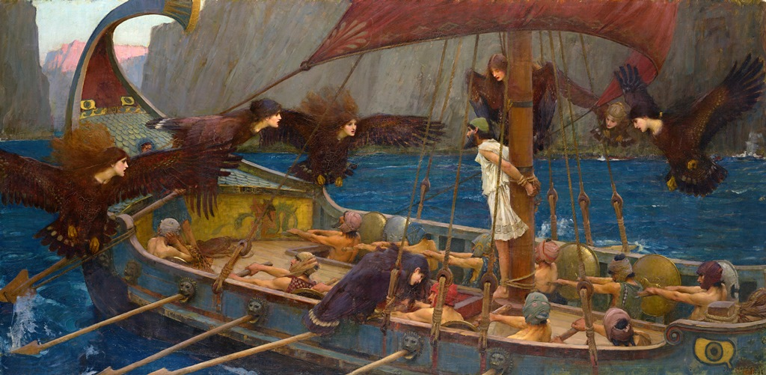
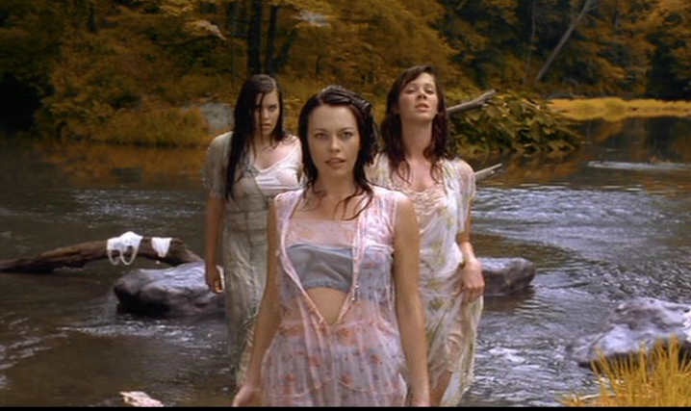
Avoiding the Sirens

Slide 15
Having made the requisite showings, the burden now shifts back to the individual defendants to establish that no disputed issues of material fact remain which would defeat the claim of qualified immunity.
Having made the requisite showings, the burden now shifts back to the individual defendants to establish that no disputed issues of material fact remain which would defeat the claim of qualified immunity.

Slide 16
As discussed in Plaintiff’s opposition to motion, Defendant began its attacks against Plaintiff’s counsel by sending him a personal subpoena during the holidays on December 29, 2008 in an attempt, believes, to set up a motion to disqualify Plaintiff’s co-trial counsel, and in an attempt to ruin his holidays. As further discussed in Plaintiff’s opposition to the motion, Defendant’s counsel engaged in Gestapo tactics in serving Plaintiff’s counsel with the subpoena in his law office without even giving a reasonable opportunity to accept service of the subpoena, or the professional courtesy of a telephone call.

Slide 17
Plaintiff asserts that Defendant accuses Plaintiff of making “disingenuous arguments” in response to various points raise in Defendant’s submission. (Application, p. 1.) Defendant’s assertion is more pointed: “Plaintiff disingenuously argues that Defendant has not substantiated its assertion that Plaintiff has failed to produce the ‘order’ source code.” Defendant’s reply brief, (pp. 1-2) In its brief in opposition Plaintiff implies that if any source code was produced for three Perl files at issue that is compliance with the Court’s September 28, 2009 order. Defendant respectfully submits that is not the case.

Slide 18
Plaintiff’s argument is a bit like suggesting that Rembrandt could not have applied proper methodology in his paintings because he did not make use of a “paint by numbers”
The assertion that Dr. P “failed to show” his work blows right by audacious and nearly steamrolls over ridiculous . . .
Even if it is necessary to reschedule the trial date, it is difficult to see how this is unfair to the defendant. "Unfairness" is often tossed out as a reason for the court to do, or not do, something. Like the cry of the loon, it is haunting, but often without substance.

Slide 19
This paragraph appears in argument without any prior recitation of these facts
Second, Defendant’s assumptions are wrong. In particular, Defendant’s Attorney’s assertion that “Defendant was not even at Plaintiff when Plaintiff developed its incremental sector tracking software,” and therefore “does not know, and could not know, anything about Plaintiff’s code for that function or the underlying source code,” is demonstrably incorrect. (8/26/11 Defendant’s Attorney’s Letter to Plaintiff’s Attorney; 9/21/11 Plaintiff’s Attorney’s Letter to Defendant’s Attorney at 2.) Incremental sector tracking was specifically requested by Company X as a deliverable, and the last Computer code drops Defendant made to Company X in 2002-well before his departure from Plaintiff-include incremental sector tracking, as evidenced by the emails on the Exhibit Disc. (See, e.g., Defendant’s 0007549, 101520-21, 101991-92, 109999-01, 110711-13, 116084-85, 158566, 170105, 203584-88, 204117-18, 205103, 205150-51, 205154-55,220109, 223744,227291, 230546, and 232179-80, collectively attached as Ex. P hereto (without exhibits).)

Slide 20
Despite the Court's ruling that Defendant Name Redacted (“Redacted”) is liable for breach of the parties' Settlement Agreement and Mutual Release signed in 20XX (the “20XX Settlement Agreement” or “Agreement”) and for copyright infringement, and that Plaintiff has presented strong evidence of Defendant's misappropriation of trade secrets, coupled with its decision to permit Plaintiff to conduct additional discovery regarding Defendant's activities while working for Company1, Company2 and/or Company3, particularly as they relate to Plaintiff's intellectual property rights and trade secrets under that Agreement, Defendant has objected to virtually all of Plaintiff's discovery issued pursuant to Magistrate Judge Nuffer's Order entered on June XX, 2011, impermissibly narrowed the scope of the discovery in providing limited substantive responses, failed to perform an adequate search for documents under Federal Rule of Civil Procedure 34, and thereby failed to produce all responsive documents.

Slide 22

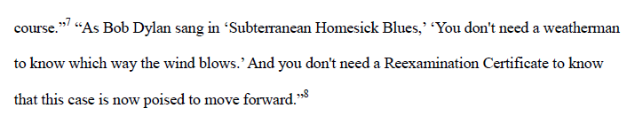

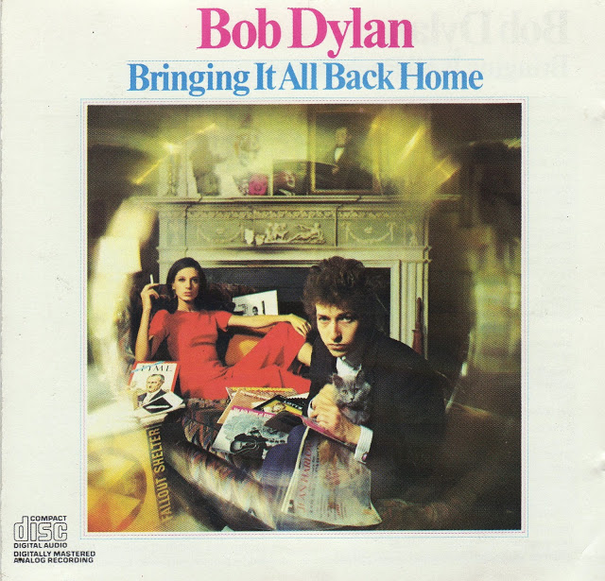
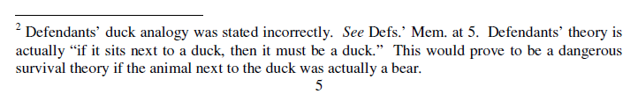
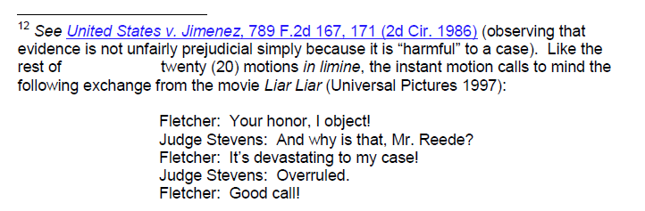

Slide 23
Avoiding the Sirens
Convoluted arguments
Characterizations
Cuteness
Long sentences
Long paragraphs
The sound of your own voice
Distractions

Slide 24
Artistry
Flow
  Is it enjoyable to read?
  Does it read as if heard, and not studied?
  Eliminate the need to re-read anything.
Would an educated person understand every word?
Is a legally trained complete stranger to the case compelled by every word?
Let it sit; then come back a day or two later.

Slide 25
John Irving on being a writer – and a wrestler
"Many of my wrestling friends find it odd that I'm a writer, just as many of my writer friends in the writing world find it odd that I was — for so many years — a wrestler and wrestling coach. But they seem very similar to me. In both cases you have to be devoted to tireless repetition and small details. For many more hours than you will be in competition, you will be with a nameless workout partner — a sparring partner, drilling the same outside single-legged dive, inside collar tie — hundreds upon thousands of times. Well, how many times as a writer do you — or should you — rewrite the same sentence, the same paragraph, the same chapter? If you're good, you never tire of that."
http://www.npr.org/2012/05/12/152361634/in-one-person-a-tangled-gender-bender

Slide 26
Avoiding Pitfalls in
Written Advocacy
David Nuffer
November 2014

