Slide 1
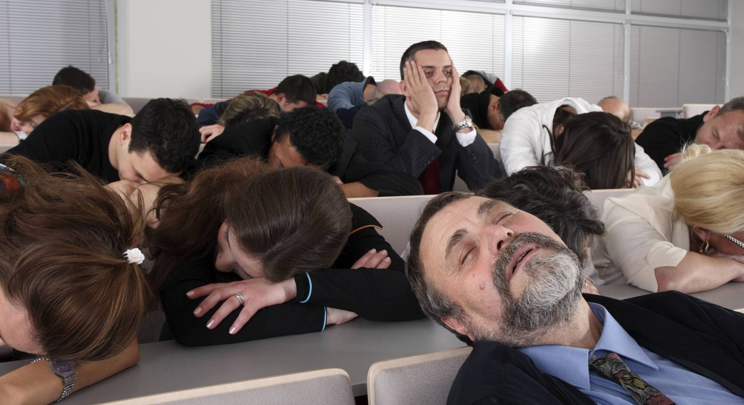
Certification

Slide 2
What is Certification of Legal Questions?
A court may certify the correct answer to a legal question to a court that ruled in error on the same issue.
A court may rule on the law of a different jurisdiction and submit the ruling to the other jurisdiction for approval.
A court of one sovereign may certify a question about the law of another sovereign to a court, agency, or tribunal of that other sovereign.
Parties in litigation may certify to the judge that a question is a legal question, not a factual question.

Slide 3
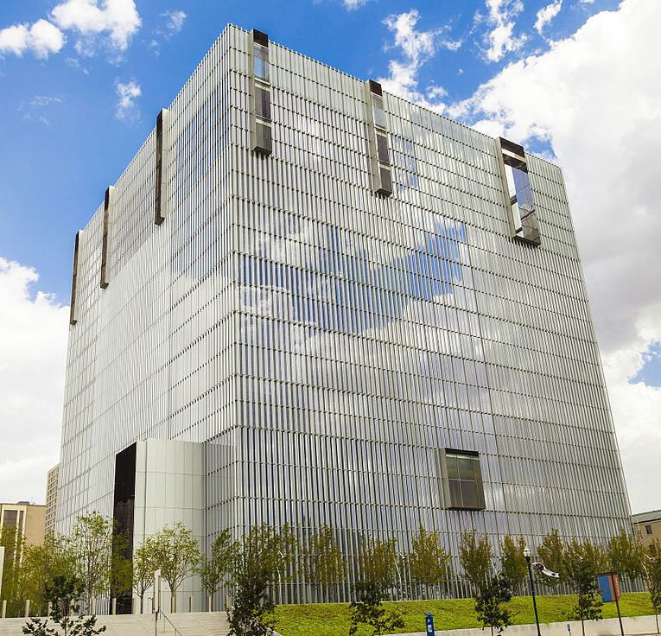
Certification Process – Federal (1)
“Controlling” Utah state law legal question arises
Suggestion to certify is made by the court (“sua sponte”) or by a motion from a party
Court determines to certify, by an order granting the motion or by advising the parties in an order or hearing
Attorneys and the judge draft facts and question to send to Utah Supreme Court
Judge signs and sends “certification order” to Utah Supreme Court with documents from court record

Slide 4
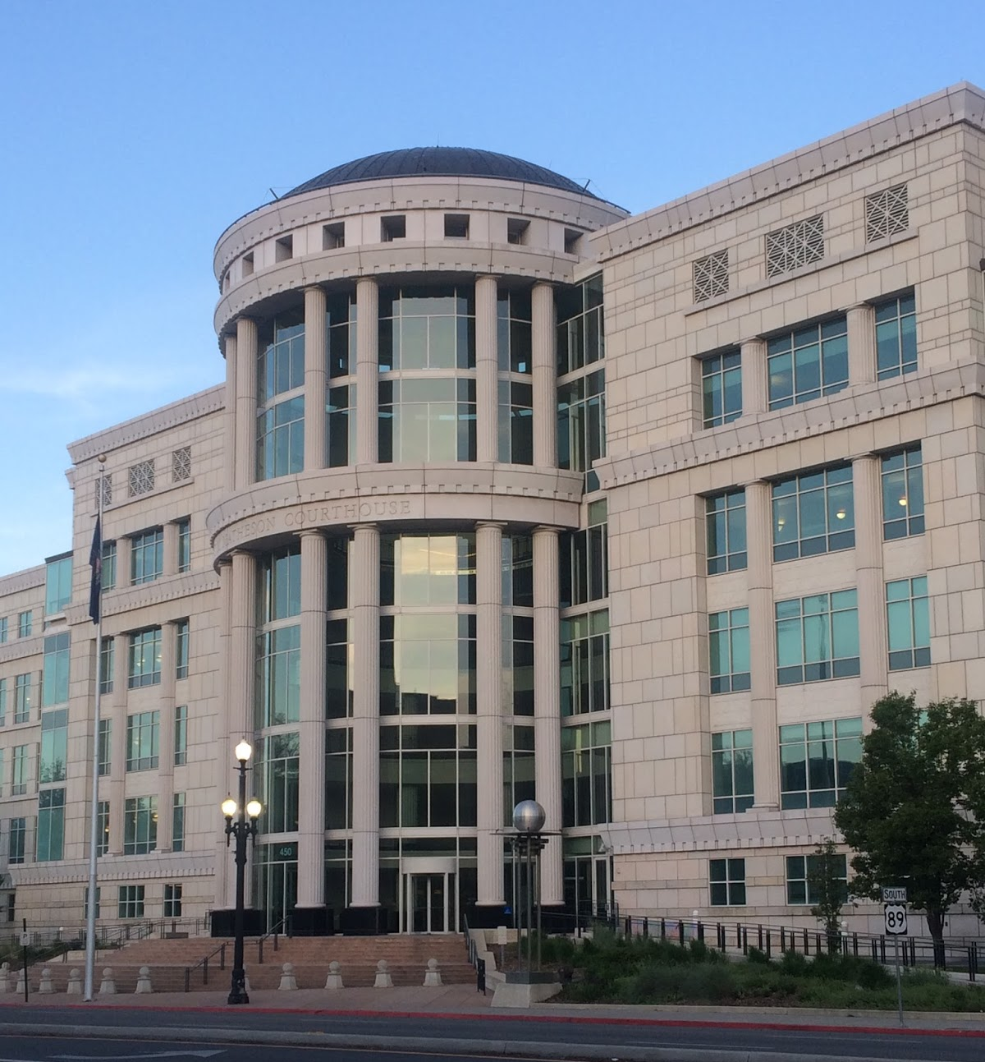
Certification Process – State (2)
Court receives certification order
Court issues an order accepting or rejecting the question certified and requests documents from federal court record
Court sets briefing schedule, receives briefs and holds argument (all these steps may be modified)
After argument, court confers and assigns opinion to a justice (another justice may write a separate opinion)
Justices issue opinion(s) answering questions (majority opinion controls)
Opinion(s) sent to federal court

Slide 5
Certification Process – Federal (3)
Federal court applies answer of Utah Supreme Court
or
Parties settle
Answer is moot
Answer is disregarded (never in Utah!)

Slide 6
What are the odds (motions)? [24/72=33%]
Trial court judge | motions | granted | % granted | years on bench
Magistrate Judge Evelyn Furse | 1 | 1 | 100% | 5 ½
District Judge Dee Benson | 9 | 6 | 66% | 26
District Judge David Sam | 3 | 1 | 33% | 31
District Judge Dale Kimball | 11 | 3 | 27% | 20
District Judge Clark Waddoups | 4 | 1 | 25% | 9
District Judge Bruce Jenkins | 9 | 1 | 11% | 31
District Judge Tena Campbell | 10 | 1 | 10% | 22
District Judge David Nuffer | 2 | 0 | 0% | 14
District Judge Jill Parrish | 1 | 0 | 0% | 2 ½
District Judge Robert Shelby | 2 | 0 | 0% | 5
District Judge Ted Stewart | 4 | 0 | 0% | 18
Magistrate Judge Paul Warner | 1 | 0 | 0% | 11

Slide 7
What are the odds (sua sponte)? (1) [32/36=88%]
Trial court judge | sua sponte | certification occurred | % certified | years on bench
District Judge Tena Campbell | 5 | 5 | 100% | 22
District Judge David Nuffer | 1 | 1 | 100% | 14
District Judge Robert Shelby | 1 | 1 | 100% | 5
District Judge Ted Stewart | 2 | 2 | 100% | 18
District Judges Waddoups/Shelby/Nuffer | 1 | 1 | 100%
Magistrate Judge Brook Wells | 1 | 1 | 100% | 14
Magistrate Judge Evelyn Furse | 1 | 1 | 100% | 5 ½
Bankruptcy Judge Kevin Anderson | 2 | 2 | 100% | 2
Bankr. Judges Clark / Bill Thurman | 1 | 1 | 100%
Bankruptcy Judge Kimball Mosier | 1 | 1 | 100% | 9

Slide 8
What are the odds (sua sponte)? (2) [32/36=88%]
Trial court judge | sua sponte | certification occurred | % certified | years on bench
District Judge Jill Parrish | 8 | 7 | 87% | 2 ½
District Judge Dee Benson | 5 | 4 | 80% | 26
District Judge Bruce Jenkins | 3 | 2 | 67% | 31
District Judge David Sam | 1 | 0 | 0% | 31
District Judge Dale Kimball | 0 | 0 | 0% | 20
District Judge Clark Waddoups | 0 | 0 | 0% | 9

Slide 9
If at first you don’t succeed . . . .
Trial court judge | Certified by Circuit | years on bench
District Judge Dee Benson | 3 | 26
District Judge Paul Cassell | 1 | 5 ½
District Judge Thomas Greene | 1 | 25
District Judge Bruce Jenkins | 2 | 31
District Judge Dale Kimball | 3 | 20
District Judge Ted Stewart | 1 | 18
District Judge Clark Waddoups | 2 | 9
TOTAL | 13
13 Circuit certifications - 9 reversals of the district court

Slide 10
Circuit practices:
The Tenth Circuit:
has never (18 instances) certified a question to the Utah Supreme Court on motion of a party made for the first time on appeal; and
has never (7 instances) reversed a district court judge’s decision not to certify a question to the Utah Supreme Court.
You MUST attempt certification at the trial court.

Slide 11
Best Practices
Get the judge to think it is the judge’s idea
Raise early and again
File a clear motion and proposed order
Don’t bury it in a motion for summary judgment or opposition
Follow the suggested local rule, even if not adopted
Brief the questions completely at the Utah Supreme Court
Offer supplemental briefing

Slide 12
Questions?

