Slide 1
Jurisdiction, Removal and Venue

Slide 2
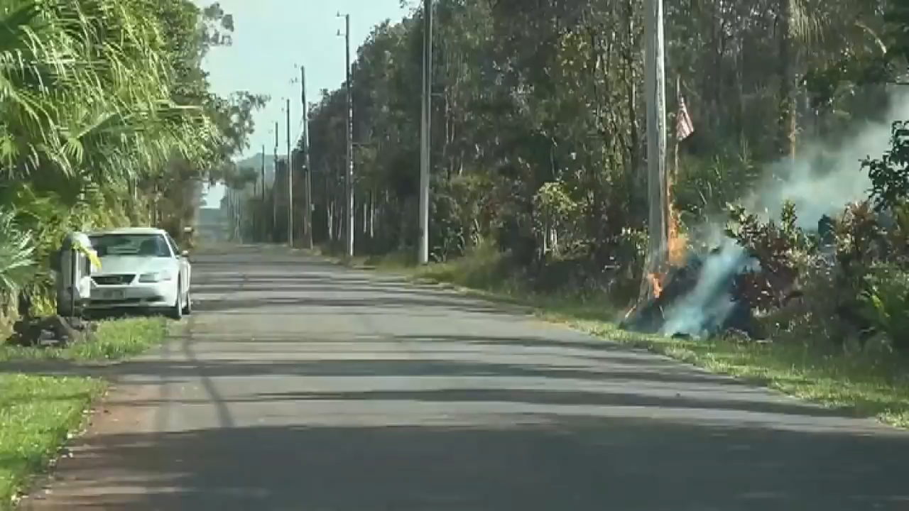

Slide 3


Slide 4
Jurisdiction

Slide 5


Slide 6


Slide 7
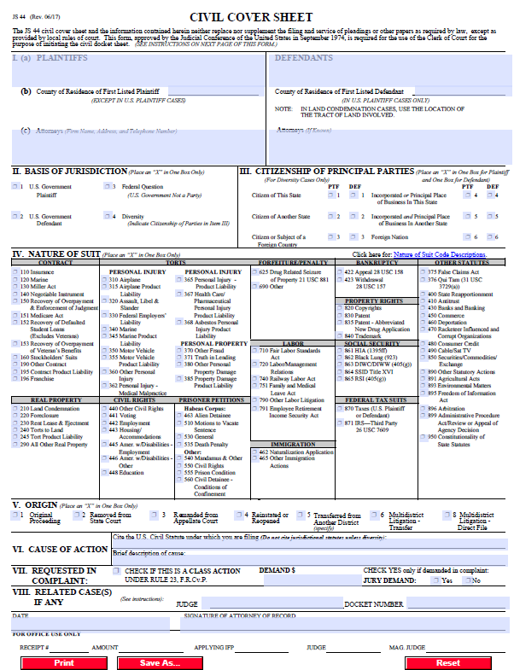

Slide 8
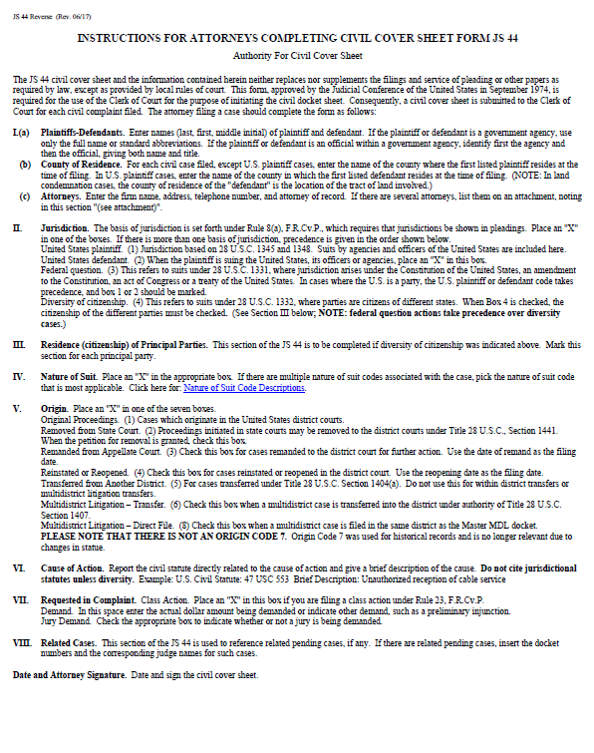

Slide 9
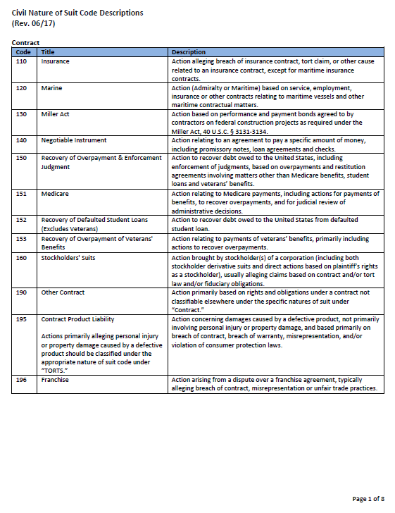

Slide 10
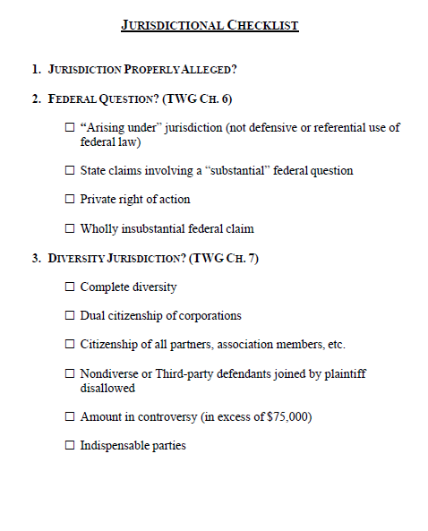

Slide 11


Slide 12
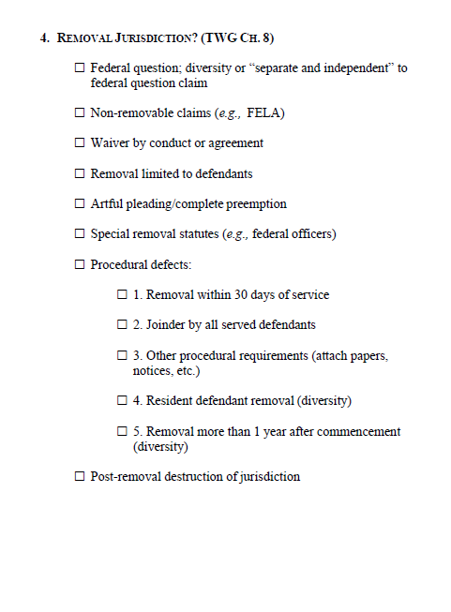

Slide 13
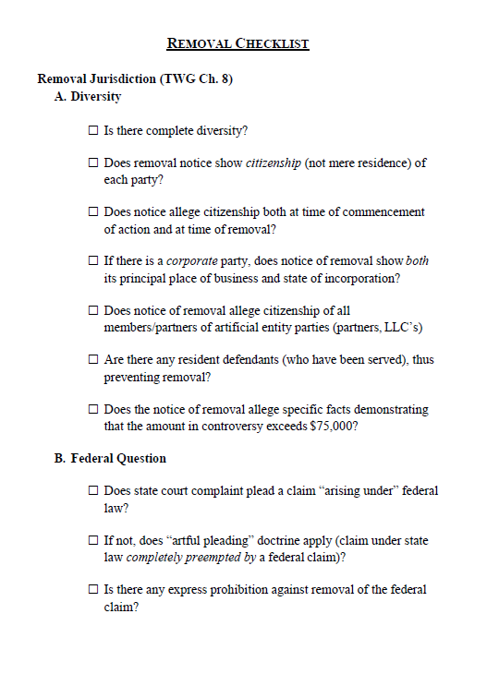

Slide 14
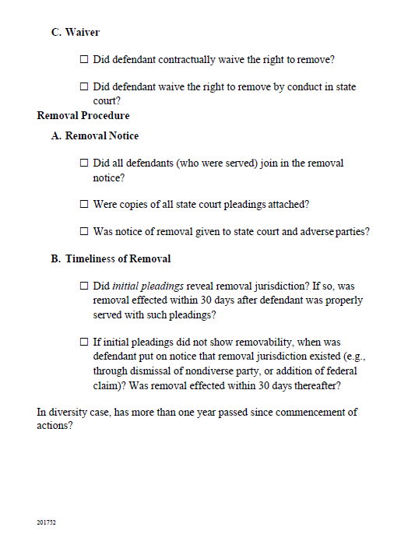

Slide 15
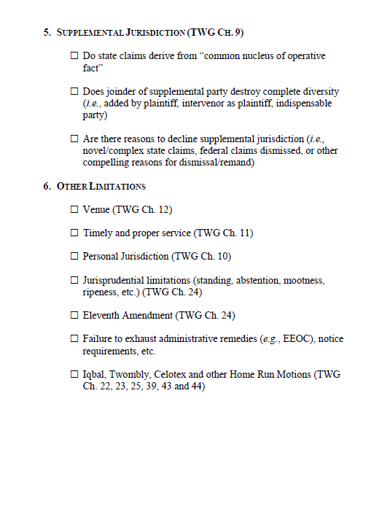

Slide 25
Waiver of Service

Slide 28
Venue Motions

Slide 29
Defendants’ and relief defendants’ motion is brought pursuant to 28 U.S.C. § 1404(a), which provides:
For the convenience of parties and witnesses, in the interest of
justice, a district court may transfer any civil action to any other
district or division where it might have been brought or to any
district or division to which all parties have consented.
“Under § 1404(a), the district court has discretion ‘to adjudicate motions for transfer according to an individualized, case by case consideration of convenience and fairness.’” Jones v. GNC Franchising, Inc., 211 F.3d 495, 498 (9th Cir. 2000) (quoting Stewart Org. v. Ricoh Corp., 487 U.S. 22, 29 (1988)).
FTC v. Wright, No. 2:13cv2215 HRH (D. Ariz. 2014) (granting motion to transfer).

Slide 30
The Tenth Circuit has developed factors to be weighed in determining whether to transfer
venue: Among the factors [a district court] should consider [are:]
[1] the plaintiff’s choice of forum;
[2] the accessibility of witnesses and other sources of proof, including the
availability of compulsory process to insure attendance of witnesses;
[3] the cost of making the necessary proof;
[4] questions as to the enforceability of a judgment if one is obtained;
[5] relative advantages and obstacles to a fair trial;
[6] difficulties that may arise from congested dockets;
[7] the possibility of the existence of questions arising in the area of conflict of laws;
[8] the advantage of having a local court determine questions of local law; and,
[9] all other considerations of a practical nature that make a trial easy, expeditious and economical.
American Covers, Inc. v. Premier Accessorry Group, LLC, Case No. 2:15cv-432 TS (D. Utah 2016) (denying motion to transfer)

Slide 31


Slide 32
Forum Selection Clauses

Slide 33
A court determines whether a forum selection clause is mandatory or permissive through ‘“an analysis of the language and an application of the principles of contract interpretation.’” Milk 'N' More, Inc. v. Beavert, 963 F.2d 1342, 1345 (10th Cir. 1992)(quoting Hunt Wesson Foods, Inc. v. Supreme Oil Co., 817 F.2d 75, 77 (9th Cir. 1987)). Mandatory forum selection clauses “contain language that is exclusive, using such terms as ‘only,’ ‘sole,’ or ‘exclusive.’” Waste Servs., No. 2:08CV417DS, 2008 WL 2856459, at *1. Permissive forum clauses, on the other hand, contain language that “give[s] a court jurisdiction without clearly making that jurisdiction exclusive.” Utah Pizza Service, 784 F. Supp. 835 at 838 (alteration in original). The language of a permissive clause “authorizes jurisdiction in a designated forum, but does not prohibit litigation elsewhere.” Daley v. Gulf Stream Coach, Inc., No. 2:99CV534C, 2000 WL 33710836, at *2 (D. Utah Mar. 3, 2000).
Secondary Sales, LLC v. USA Truck, 2:15:cv130DAK, (D. Utah 2015)

Slide 34
The forum selection clause in this case is clearly permissive. The clause states that “the parties hereby consent to the jurisdiction of the courts of Crawford County, Arkansas . . . ,” but the clause does not contain language prohibiting litigation elsewhere. The clause in this case has essentially the same meaning as the language of the forum selection clause found to be permissive in Utah Pizza Service, which allowed parties to “submit” to jurisdiction in the designated forum without including any other words to indicate that jurisdiction was exclusive. Utah Pizza Service, 784 F. Supp. 835 at 838. Accordingly, the Defendant’s Motion to Dismiss for lack of jurisdiction and improper venue is denied.
Secondary Sales, LLC v. USA Truck, 2:15:cv130DAK, (D. Utah 2015)

Slide 35


Slide 36
D'oh! - Wikipedia
https://en.wikipedia.org/wiki/D%27oh!
"D'oh!" (/doʊʔ/ DOH) is a catchphrase used by the fictional character Homer Simpson, from the long-running American animated sitcom The Simpsons (1989–present). It is typically used when Homer injures himself, realizes that he has done something stupid, or when something bad has happened or is about to happen to him.
‎

Slide 38


