Slide 1

Making Tablet Friendly E-Filings
Federal Bar Association
Judge David Nuffer
District of Utah
This PowerPoint presentation and the accompanying handout are both found at http://www.utd.uscourts.gov/judges/nuffer_resources.htm#Continuing

Slide 2
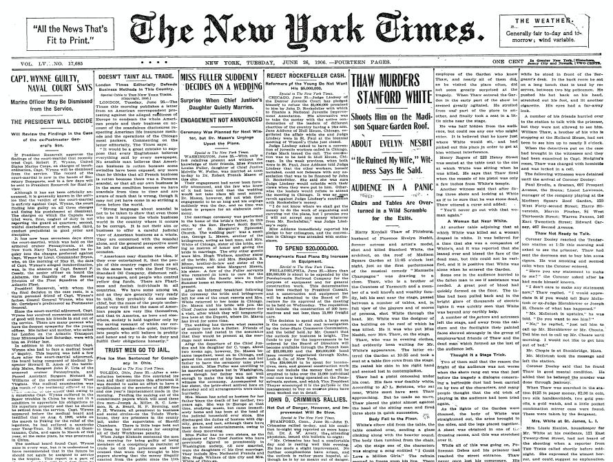
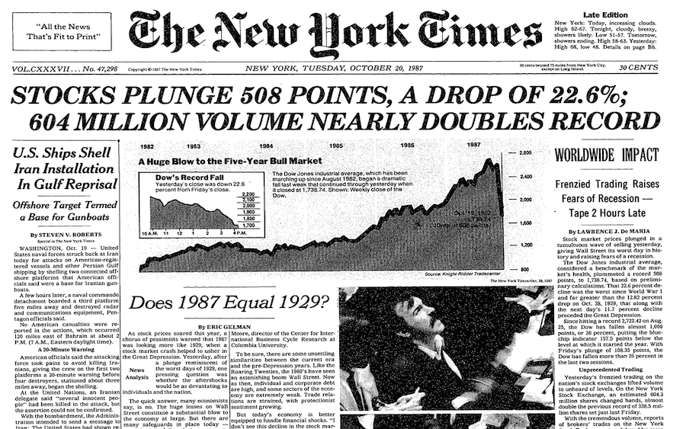
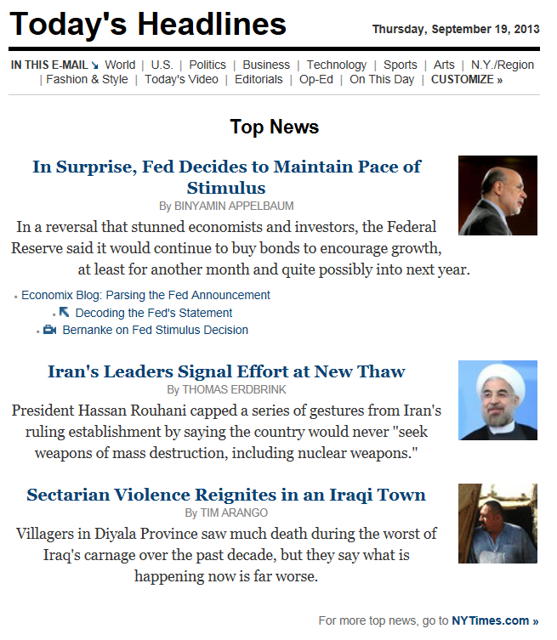
Notes:
Information delivery has evolved, even in the same industry. Newspapers started as flat text. [CLICK] Then they added photos. Both of these were hard copy paper delivery. [CLICK] Now news comes like this, electronically, with photos and links.

Slide 3
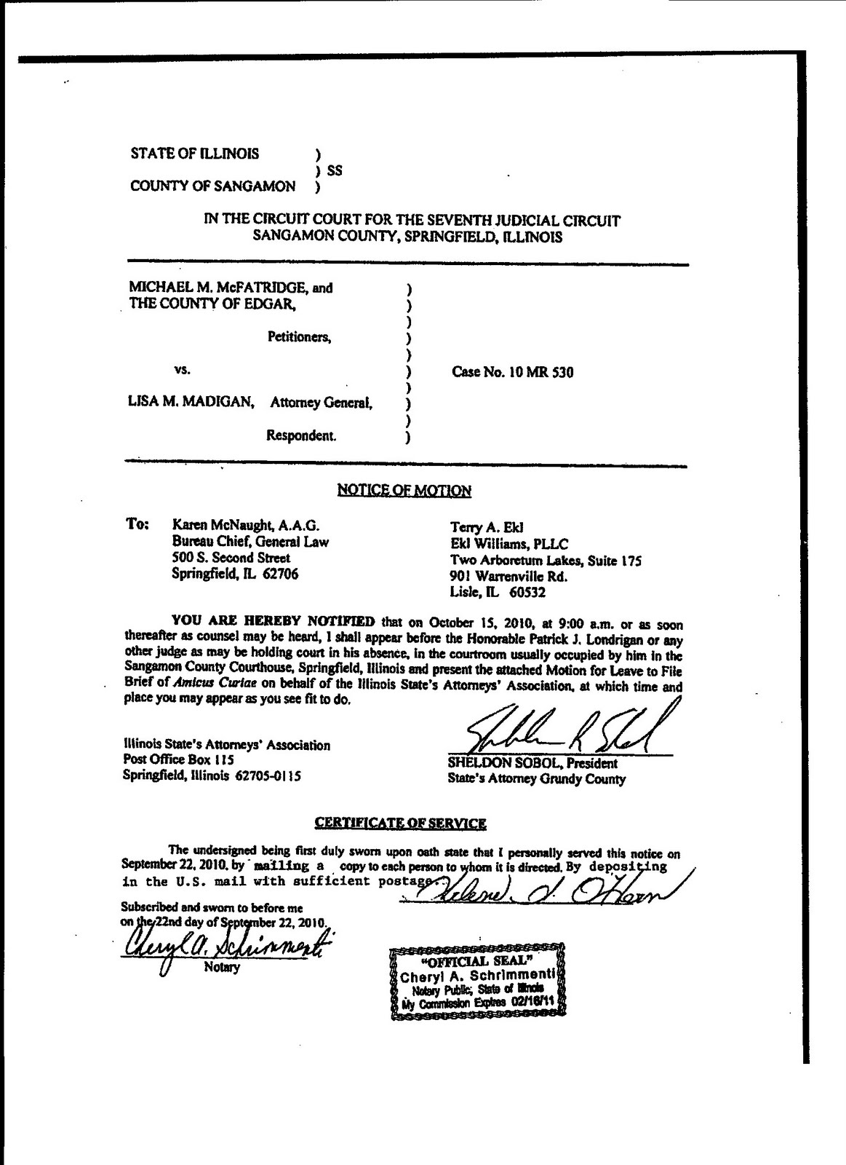
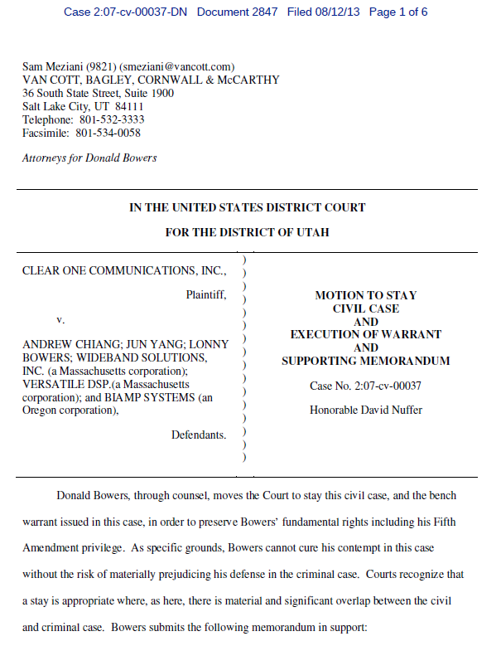

Slide 4
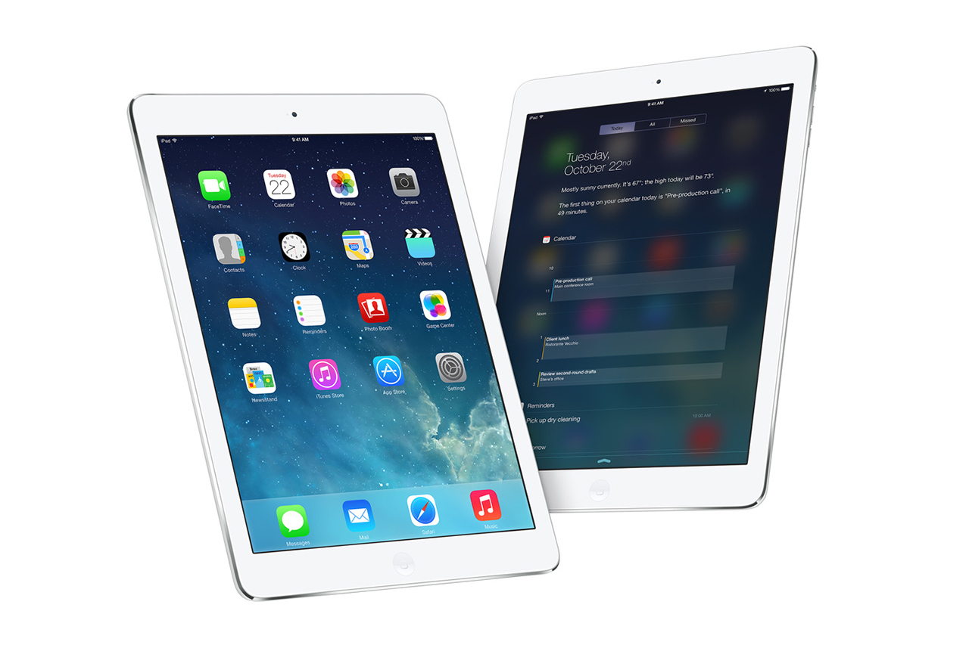

Slide 5
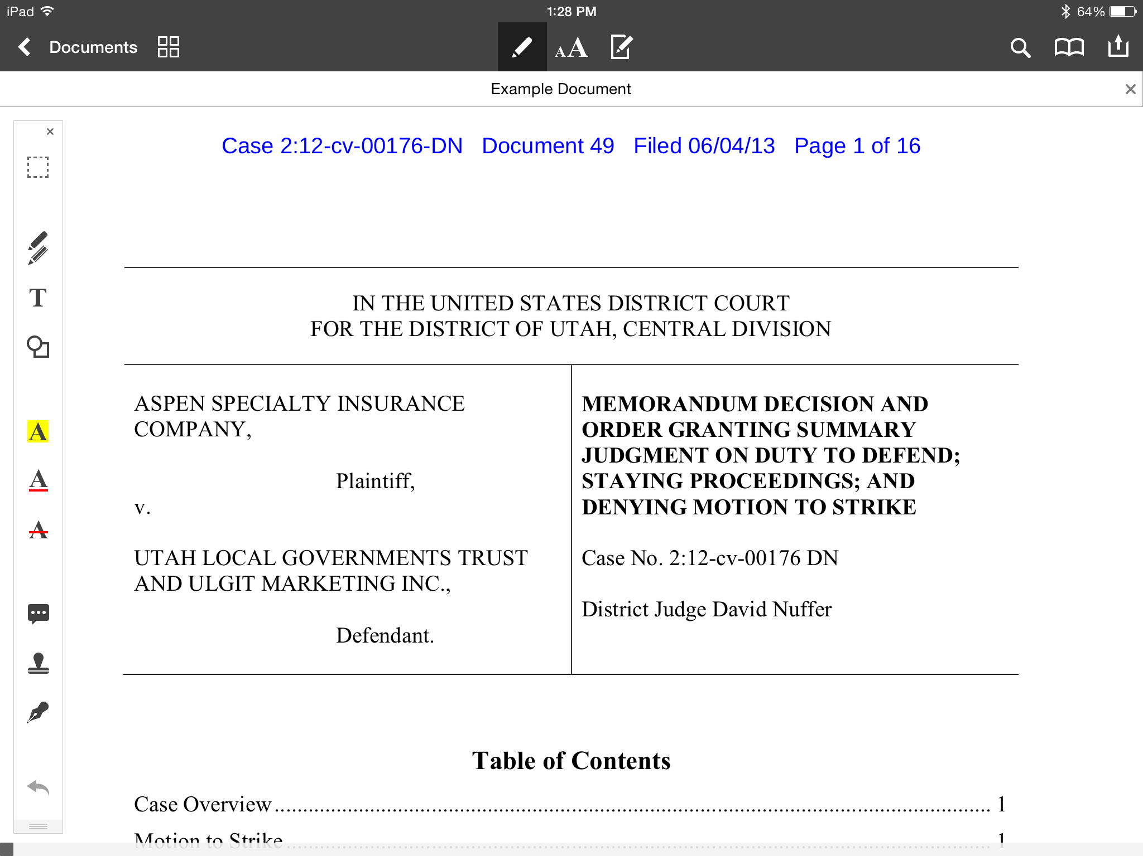
Screen shots showing bookmarks, toc, annotation tools

Slide 6
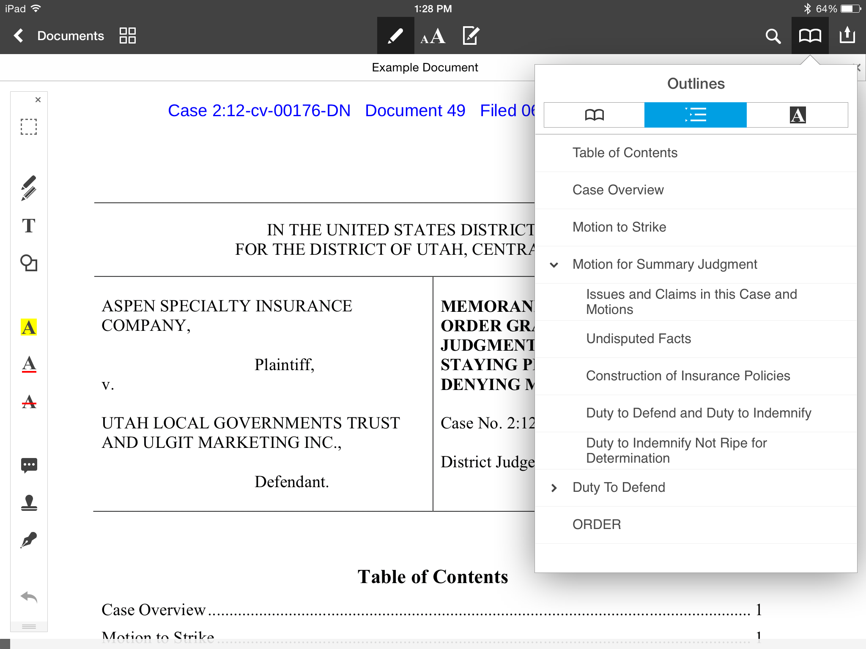

Slide 7
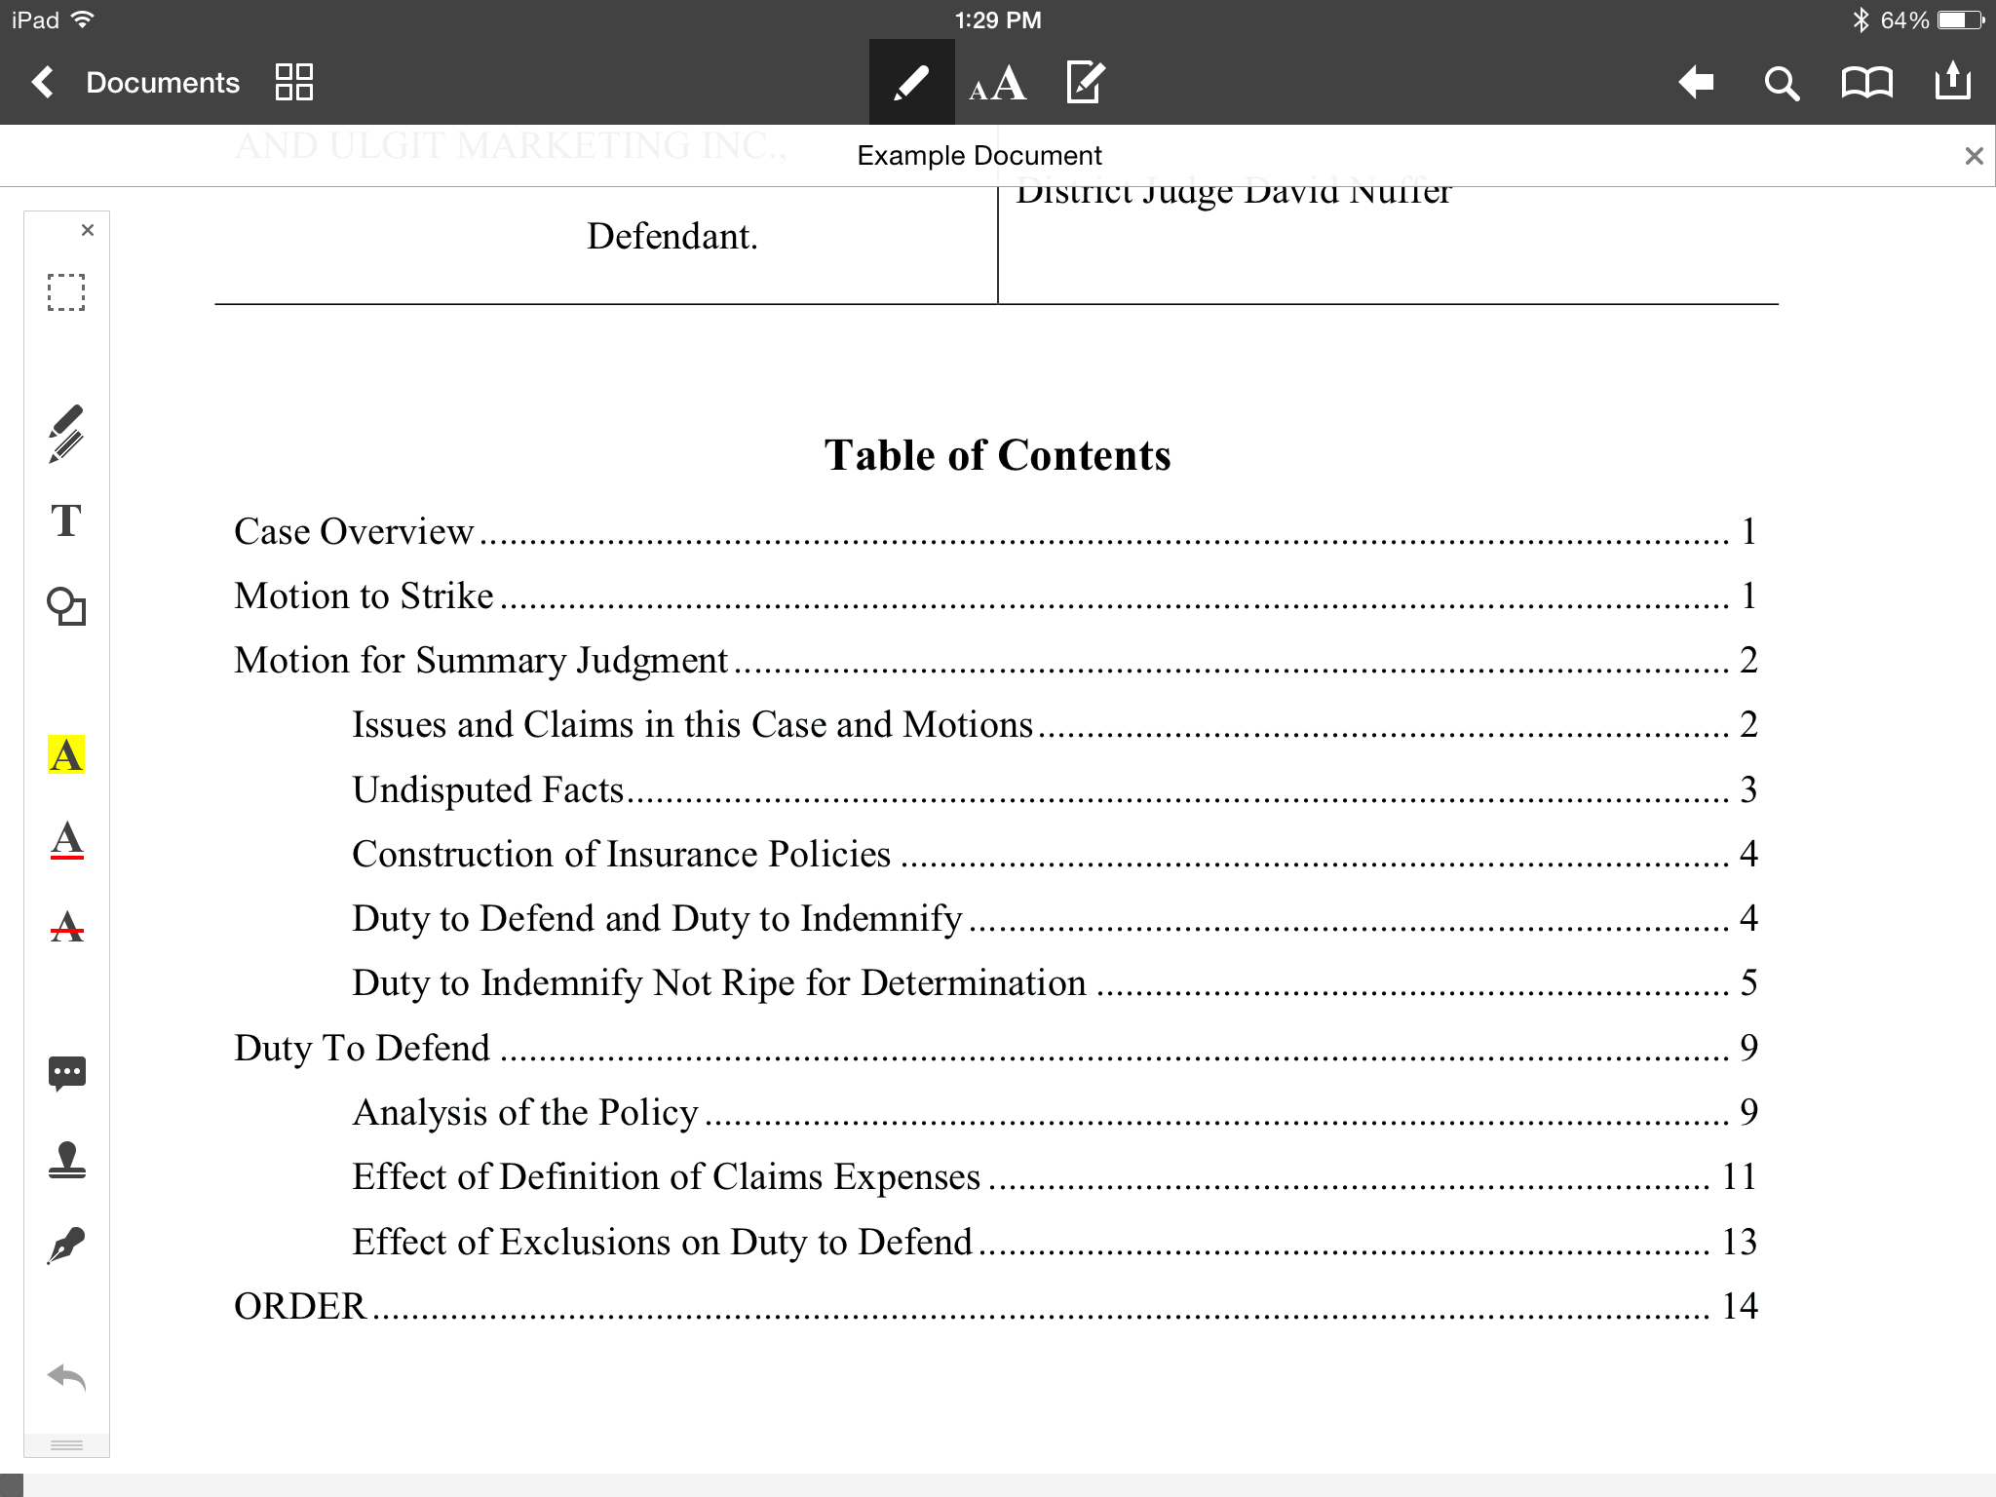

Slide 8
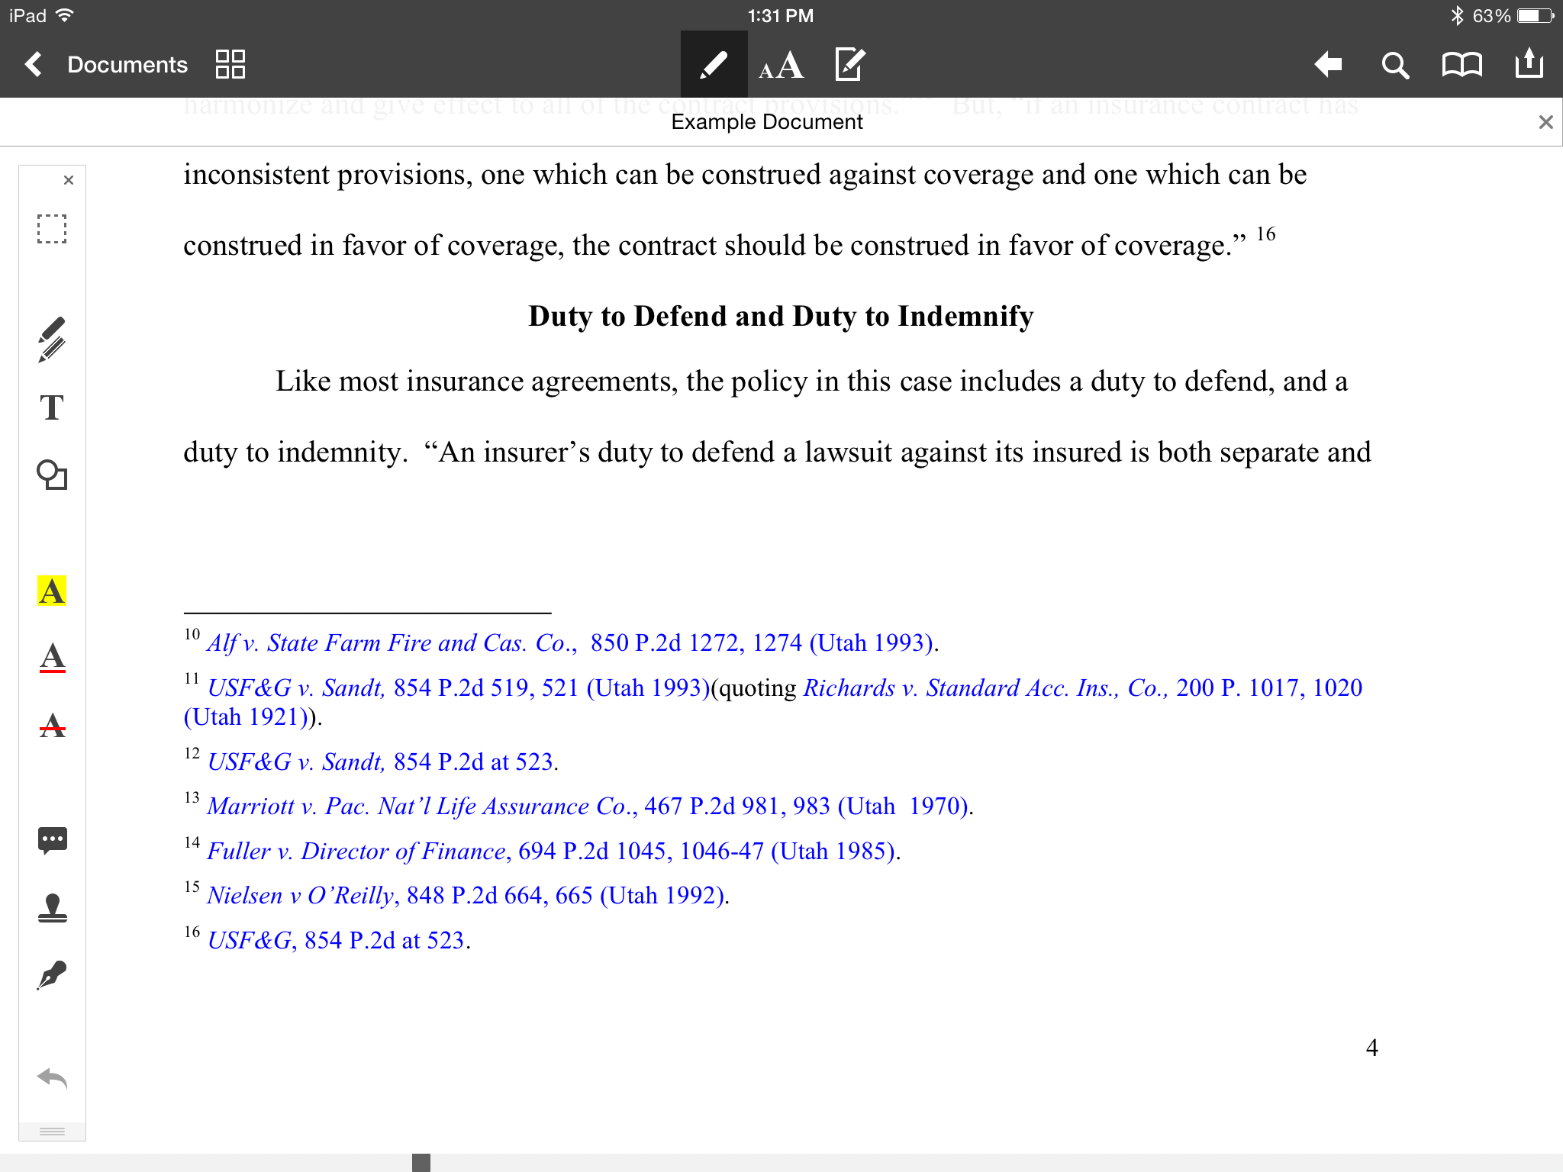

Slide 9
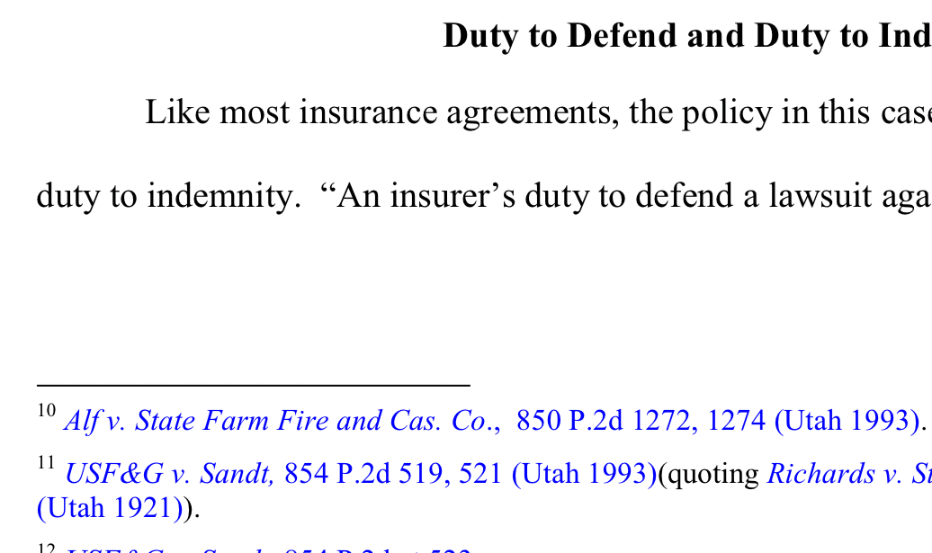

Slide 10
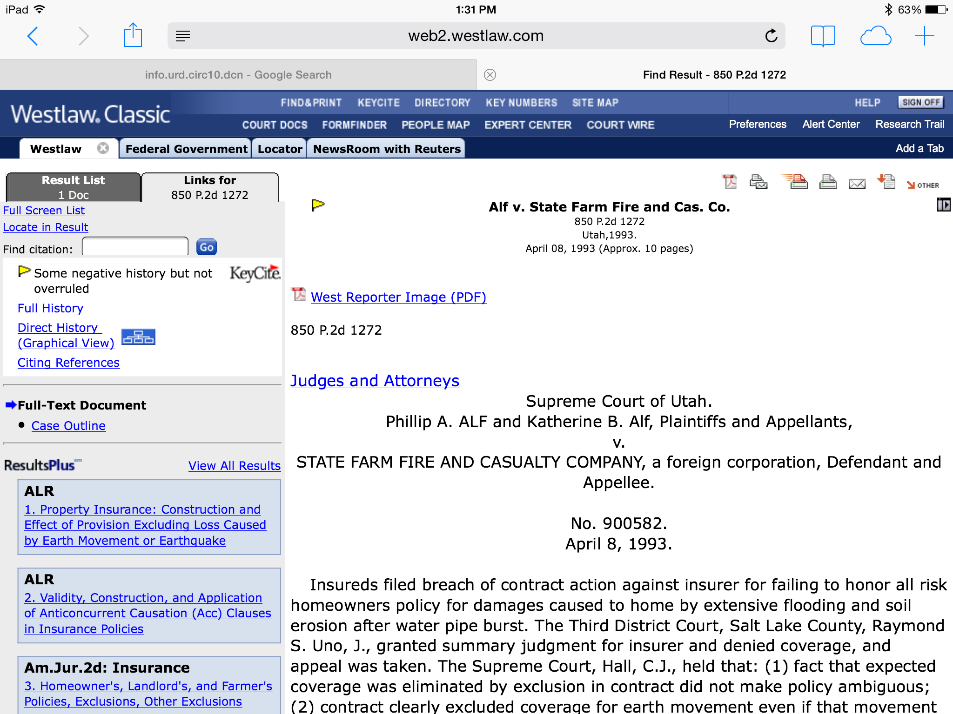

Slide 11
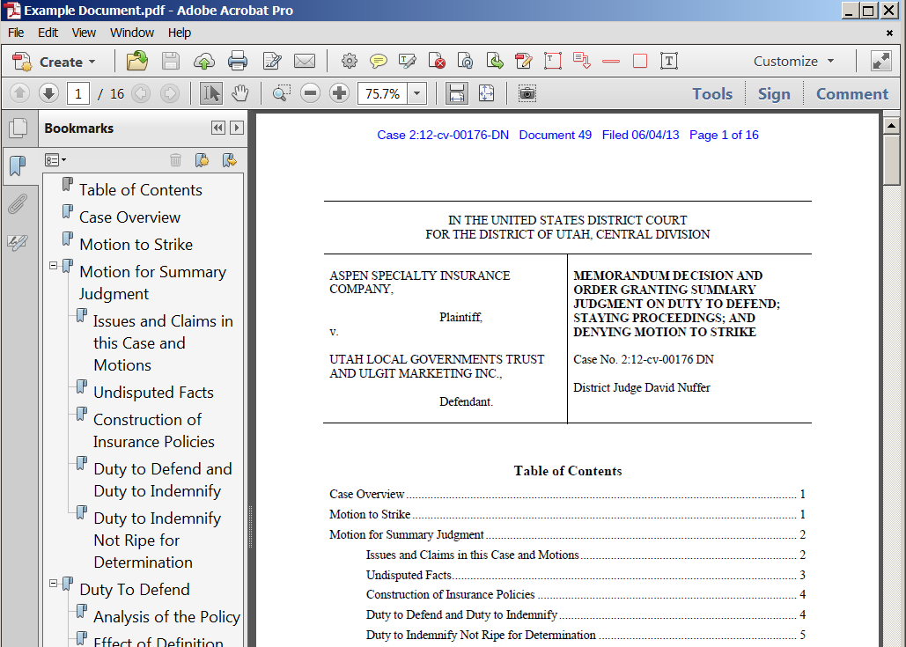

Slide 12
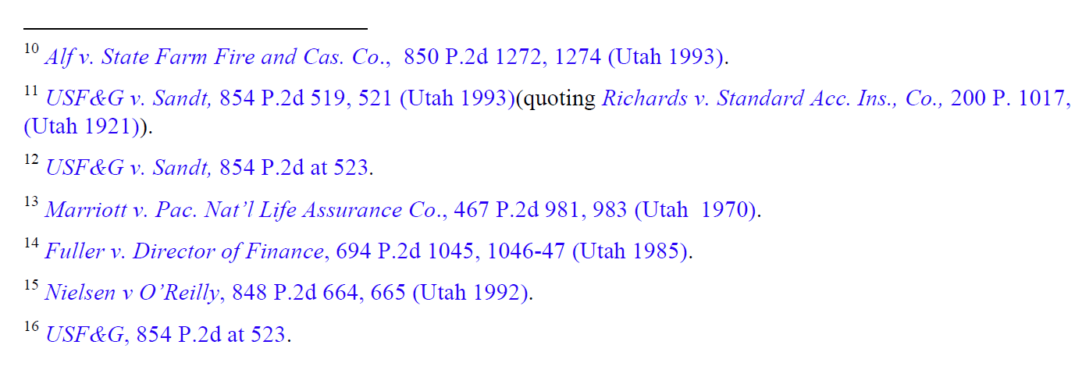

Slide 13
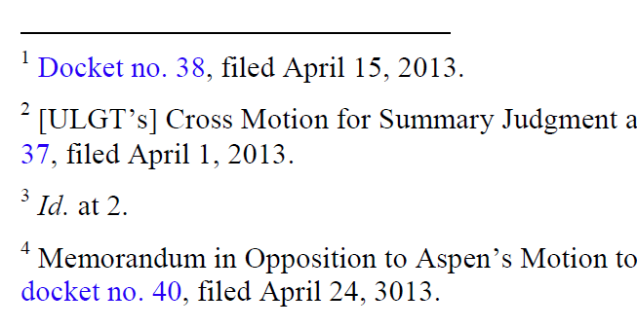

Slide 14
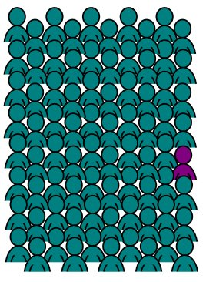
Disclaimer #1
I may be the only judge you ever run across who cares about this stuff.
But it is good to know what you might need.
Notes:
Before we get started, four disclaimers:

Slide 15



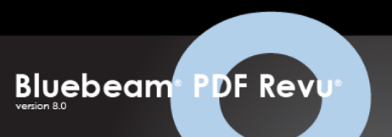
Disclaimer #2
Software shown is illustrative only. Many products do the same things.

Slide 16
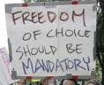
Disclaimer #3
These are suggestions.
Not requirements.

Slide 17
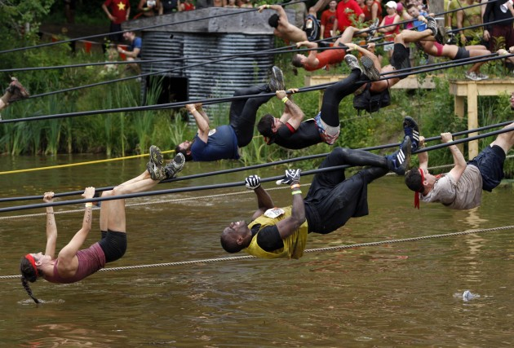
Disclaimer #4
No heroic efforts, please. Be reasonable.
Not meant to increase time or expense.

Slide 18
Corollary to Disclaimer #4
80 – 20 Rule (Pareto Principle)
“for many events, roughly 80% of the effects come from 20% of the causes”
Notes:
Italian economist Vilfredo Pareto observed in 1906 that 80% of the land in Italy was owned by 20% of the population; he developed the principle by observing that 20% of the pea pods in his garden contained 80% of the peas.
80% of sales come from 20% of customers
80% of content comes from first draft.
http://en.wikipedia.org/wiki/Pareto_principle

Slide 19
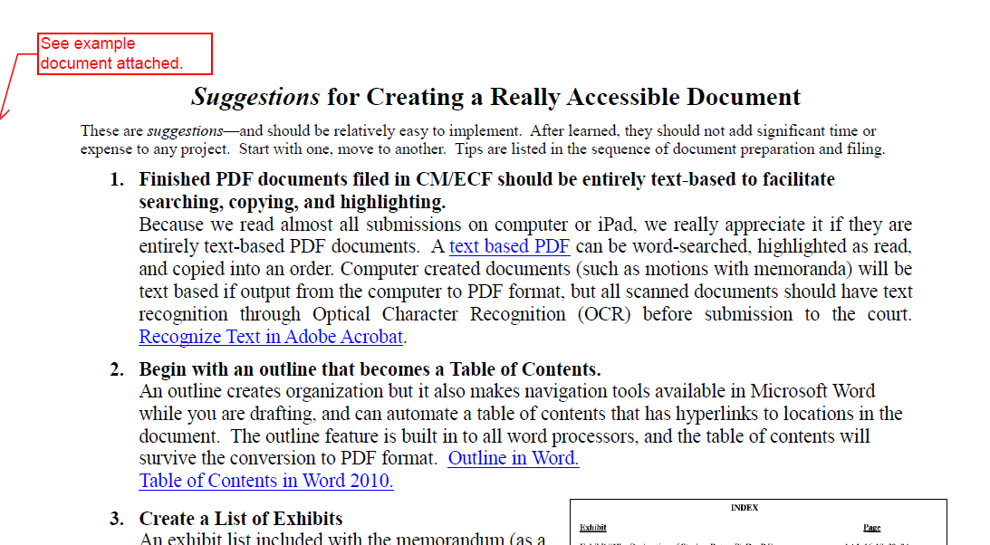
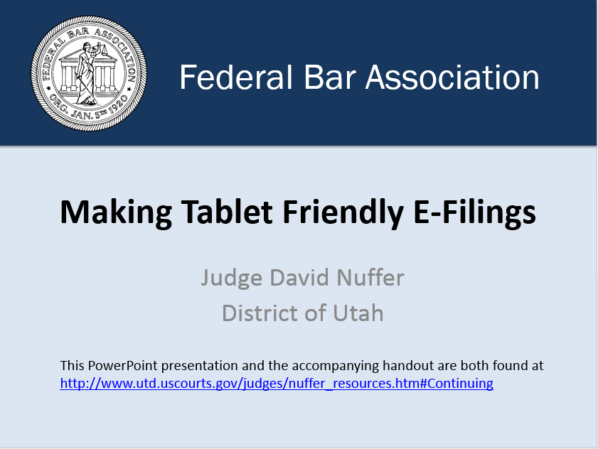
Handout vs Powerpoint
Handout
Links and details
Runs sequentially
Powerpoint
General
Topical organization

Slide 20
Topics
“Text based” documents
Navigation tools
Hyperlinks
Finishing
Filing

Slide 21
The Goal – Text Based PDF
Finished PDF document
must be entirely text-based
to facilitate searching, copying, highlighting.

Slide 22
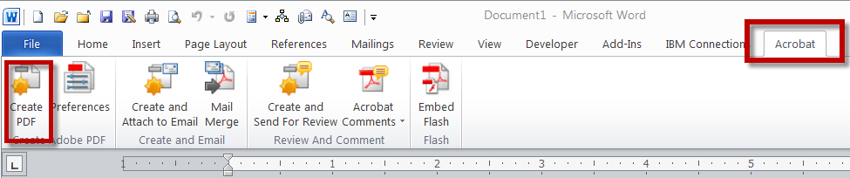
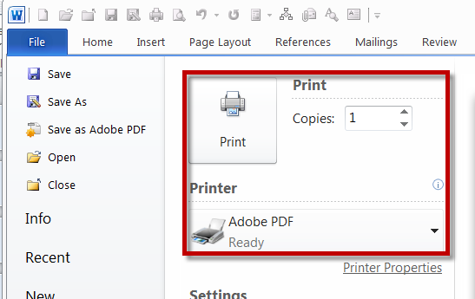
The Goal – Text Based PDF

Slide 23
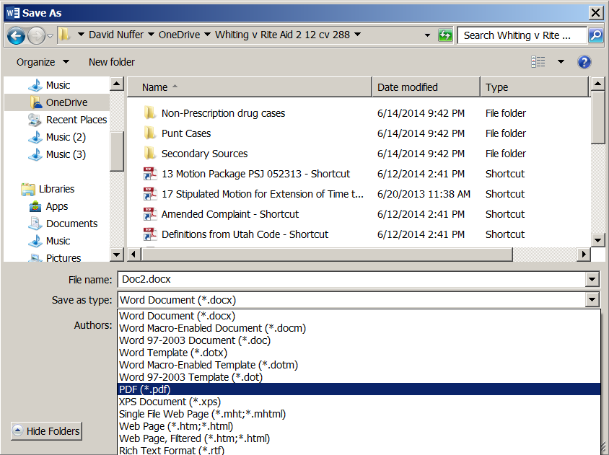
The Goal – Text Based PDF

Slide 24
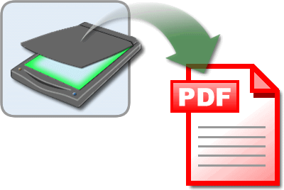
The Goal – Text Based PDF
Is this scan
REALLY necessary?

Slide 25
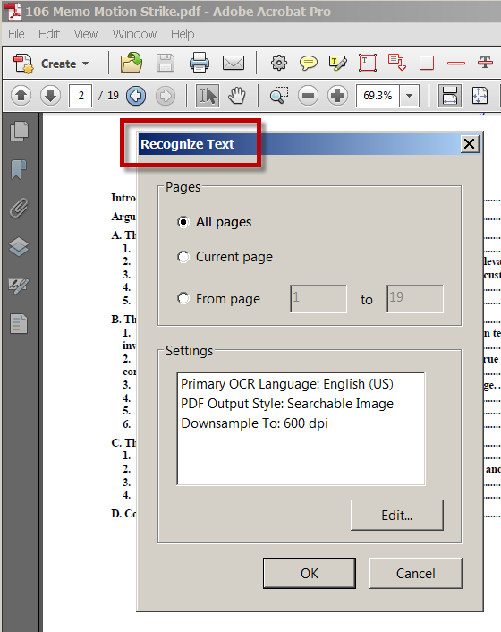
The Goal – Text Based PDF
If you must scan . . .

Slide 26
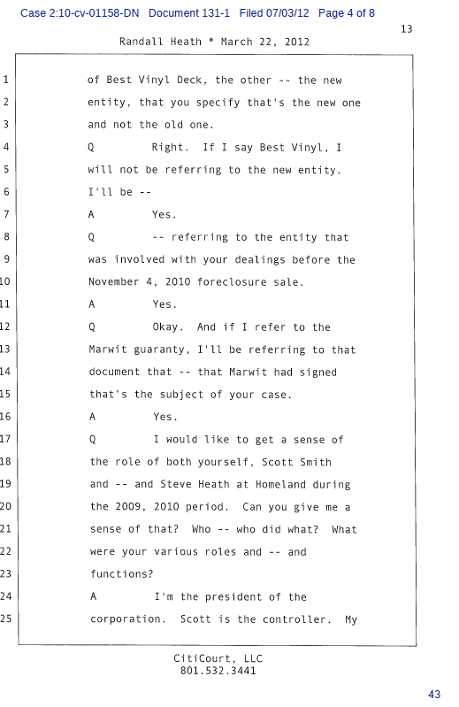
Text Based Attachments
All attachments in text-based PDF format
Output from word processing or text file
OCR if scanned in
(high quality scan needed)

Slide 27
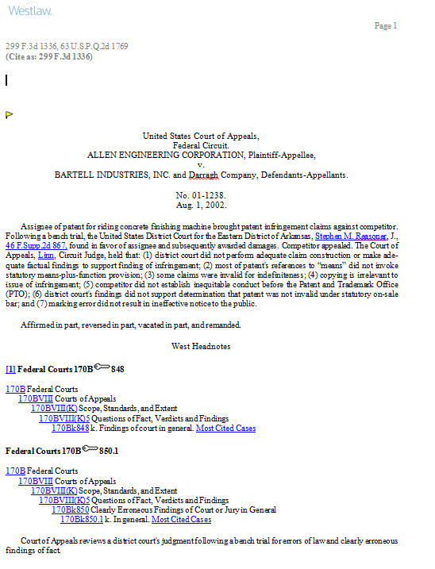
Text Based Opinions
Opinion attachments in single column format (text based)

Slide 28
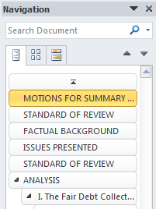
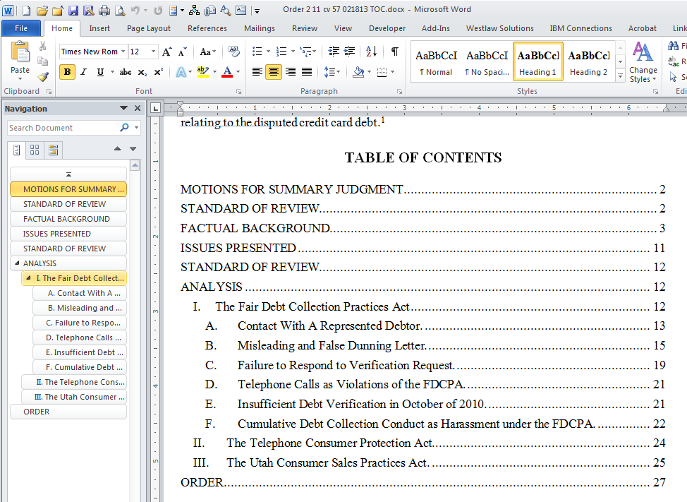
Navigation Tools
Begin with an outline, that becomes a table of contents.
Notes:
It helps while you write, in the navigation pane, and becomes bookmarks and links when the document is converted to PDF.

Slide 29
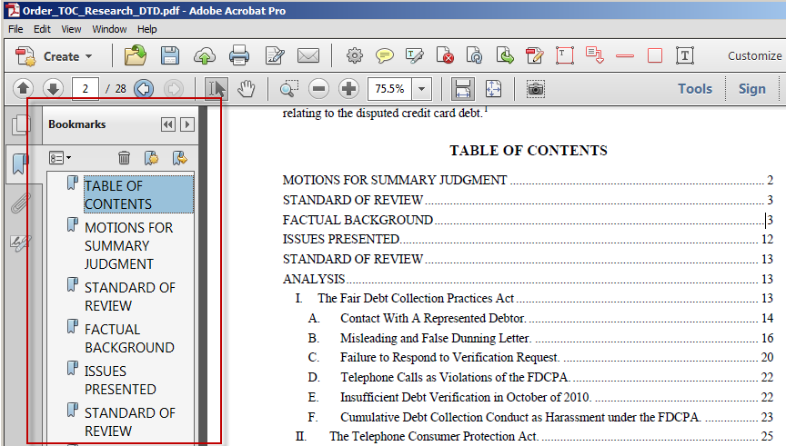
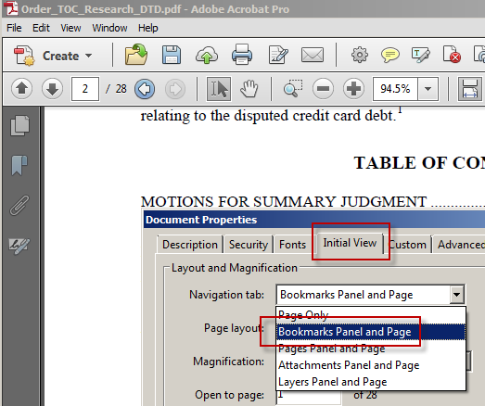
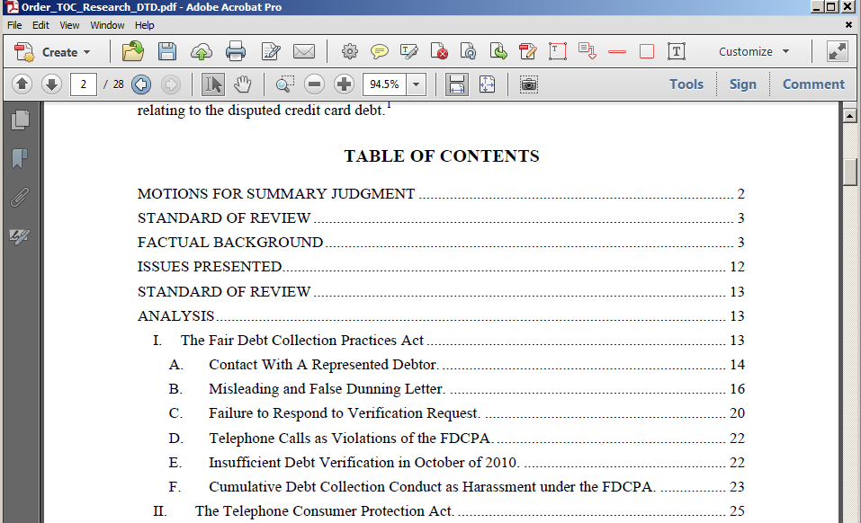
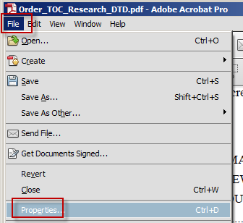
Navigation Tools
After PDF conversion, force the bookmarks panel to show.
Notes:
It helps while you write, in the navigation pane, and becomes bookmarks and links when the document is converted to PDF.

Slide 30
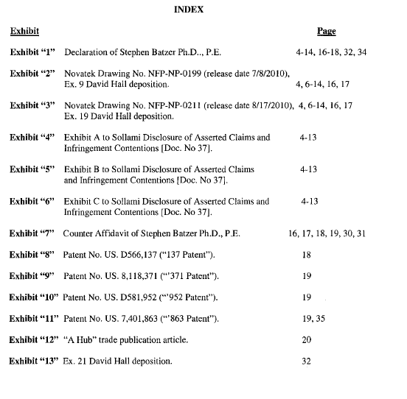
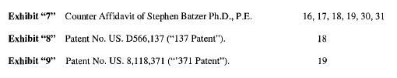
Navigation Tools
Create a
List of
Exhibits

Slide 31
Use Permissible Hyperlinks
Internal links – TOC and references
Research links – links to statutes, cases, rules
Document to Document links

Slide 32
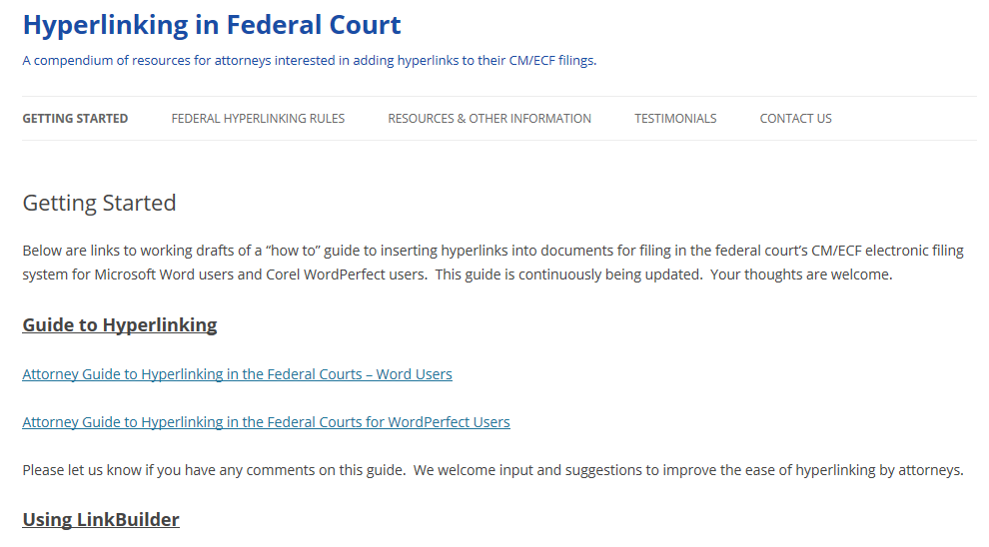
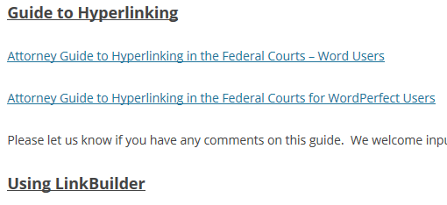
federalcourthyperlinking.org

Slide 33
Check your local rules
DUCivR 7-5 HYPERLINKS IN COURT FILINGS
(a) Permissible and Impermissible Hyperlinks.
As a convenience for the court, practitioners are encouraged to utilize hyperlinks in a manner consistent with this rule.

Slide 34
DUCivR 7-5 HYPERLINKS IN COURT FILINGS
(1) Encouraged Hyperlinks.
(A) Hyperlinks to other portions of the same document and to material elsewhere in the record, such as exhibits or deposition testimony, are encouraged.
(B) A hyperlink to a government site or to legal authority from recognized electronic research services, such as Westlaw, Lexis/Nexis, Google Scholar, Casemaker, Fastcase or Findlaw is encouraged.

Slide 35
DUCivR 7-5 HYPERLINKS IN COURT FILINGS
(2) Permissible Hyperlinks.
A hyperlink to any other internet resource . . . is permissible . . . provided that the attorney . . . downloads the content . . . and attaches it . . . in PDF format, or [submits a media object conventionally]

Slide 36
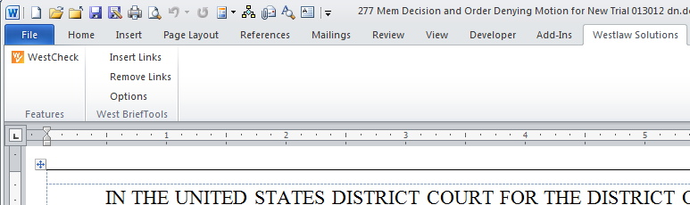
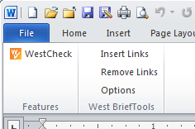
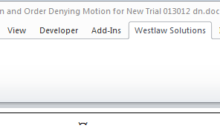
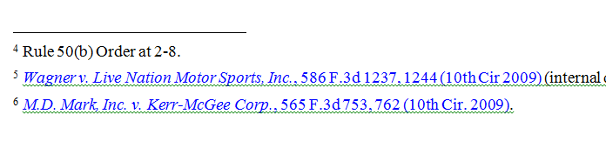
Creating Research Links

Slide 37
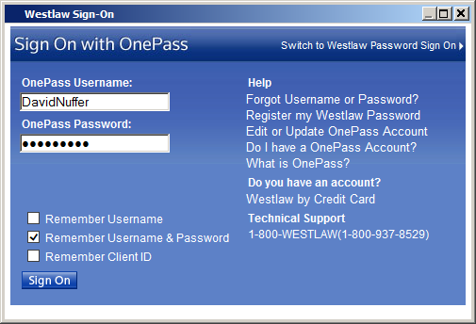
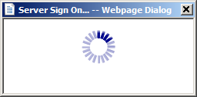
Creating Research Links

Slide 38
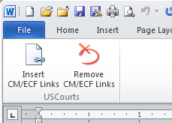
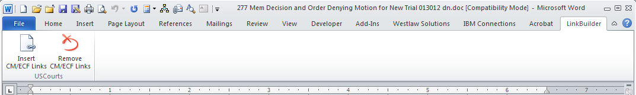
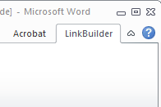
Creating Links to
Previously Filed Documents

Slide 39
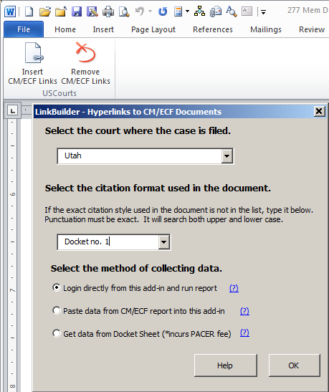
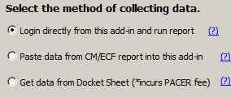
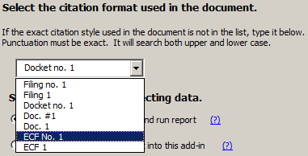


Creating Links to
Previously Filed Documents

Slide 40







Slide 41




Slide 42

federalcourthyperlinking.org

Slide 43

Creating Links to
Concurrently Filed Documents
Must be done manually.
In the main document, create a link to the other document.
Uploading the PDFs to CM preserves the links.

Slide 44

Last Steps
Save As Reduced Size PDF

Slide 45
Last Steps
Attach proposed order in PDF format – and email in word processing format to chambers.
Proposed orders [etc.] shall be (i) prepared as word processing documents; (ii) saved in WordPerfect or Word format, and (iii) transmitted to the assigned judge via email. . . .
An additional copy . . . shall be saved as a PDF file and filed electronically as an attachment to the motion . . . Admin E-Filing Procedures II. G. 1.

Slide 46


Last Steps
File attachments individually, with full descriptions

Slide 47

Final Step

Slide 48
Making Tablet Friendly E-Filings
Federal Bar Association
Judge David Nuffer
District of Utah
This PowerPoint presentation and the accompanying handout are both found at http://www.utd.uscourts.gov/judges/nuffer_resources.htm#Continuing

