Slide 1

Introduction to the
Federal Court

Slide 2
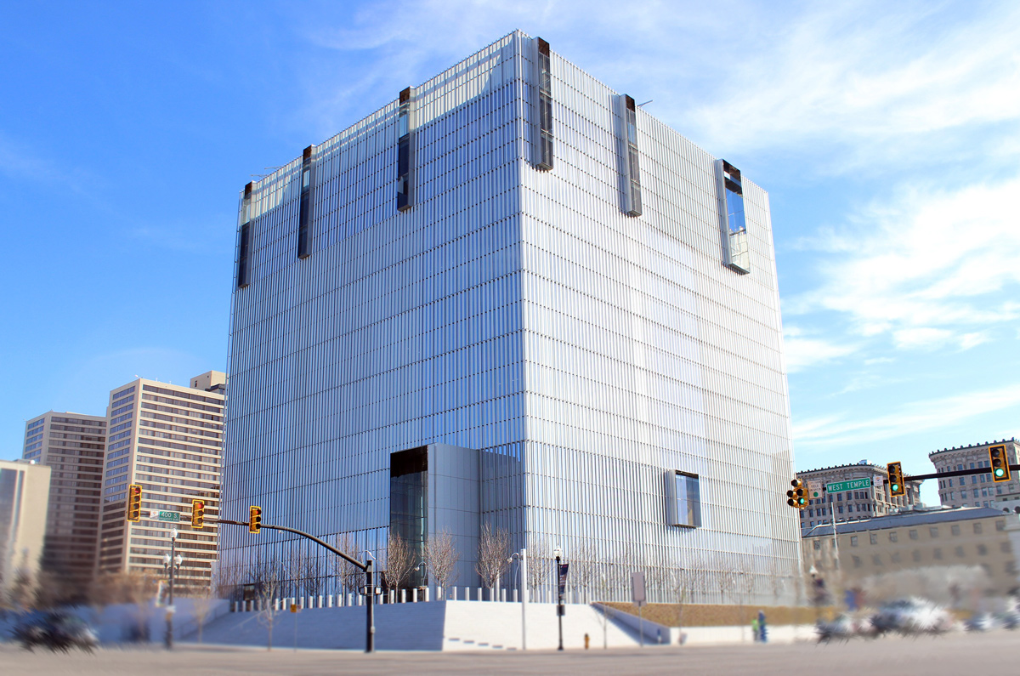
U.S. District Court
District of Utah

Slide 3
U.S. District Court
Part of the 10th Circuit centered in Denver
  Utah, Wyoming, Colorado, New Mexico, Kansas, Oklahoma
4 Active District Judges
1 Vacancy
6 Senior District Judges
5 Magistrate Judges (including 1 in St. George)

Slide 4
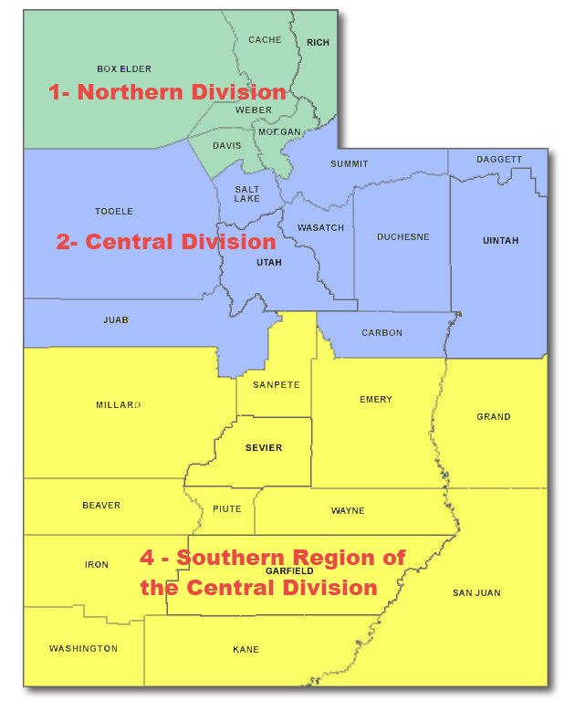
District of Utah
District of Utah – consists of entire state
2 divisions: Northern and Central
  Northern
    Box Elder, Cache, Rich,
    Weber, Davis, Morgan
  Central – all others
    Southern Region:
      Millard, Sanpete, Sevier,
      Emery, Grand, Beaver, Piute,
      Wayne, Iron, Garfield, San Juan
      Washington, and Kane

Slide 5
Structure
District of Utah
Chambers and
Clerk’s Office

Slide 6
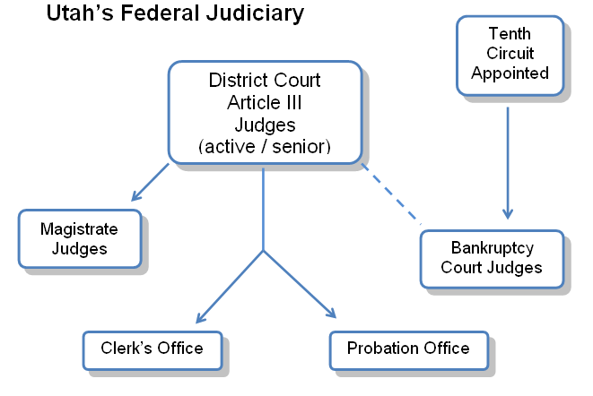

Slide 7
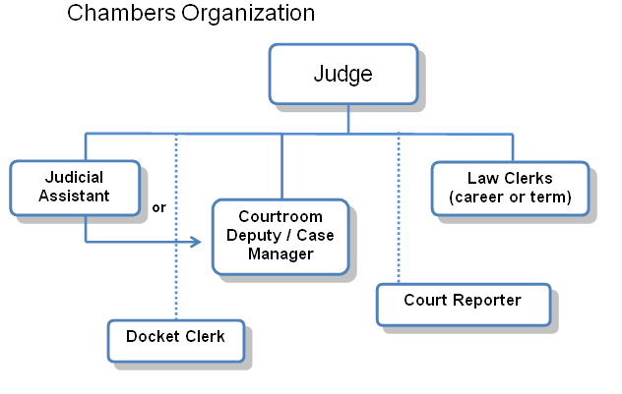

Slide 8
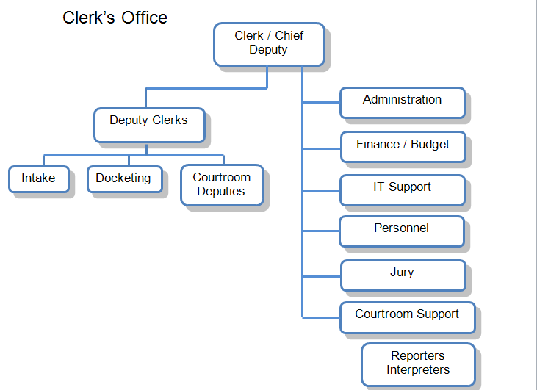
Information
Technology
Operations
Human
Resources
Court Reporters

Slide 9
The Federal Bar and Federal Bar Association

Slide 10
The Bar and FBA
Federal Bar Membership – District of Utah
  Separate from Utah State Bar membership
  Must be an active member in good standing with the Utah State Bar.
  Motion for Admission made by member of Utah Bar or—for biennial joint ceremony—by Utah State Bar. Motion granted by chief judge.
  Oath administered by a judge, clerk of court, or chief deputy
  Initial registration fee of $181 and annual renewal fee of $30.
FBA Membership (National Association)
  Member of any state or federal bar
  “Dedicated to the advancement of the science of jurisprudence and to promoting the welfare, interests, education, and professional development of all attorneys involved in federal law.”
  Payment of annual dues

Slide 11
Filing a New Complaint in Federal Court

Slide 12
Types of Complaints
Federal Question
  Civil Rights (including prisoner civil rights)
  Employment Discrimination
  ERISA Cases (Denial of Insurance Benefits)
  Patent, Trademark, Copyright
  Claims Against the United States (e.g., Federal Torts Claims Act)
  Appellate Review of Bankruptcy Decisions and Administrative Agency Decisions (e.g., Denial of Social Security Benefits; Decisions Pursuant to Various Environmental Statutes)
Diversity Jurisdiction
  Breach of Contract
  Torts
  Property Rights

Slide 13
TWO Systems for
E-Filing
Case Management/Electronic Case Filing (CM/ECF)
Public Access to Court Electronic Records (PACER)

Slide 14
CM/ECF
CM/ECF - Internet-based document FILING system
  Allows for immediate electronic notification and filing of PDF documents on the official court record.
User-friendly
24/7 Access to filing.
Any device with Internet connection and web browser software can access CM/ECF (Internet Explorer and Mozilla Firefox best; Google Chrome not recommended.)

Slide 15
PACER
PACER – Internet-based document RETRIEVAL/VIEWING system
  Subscription service
  Separate Login and Password than CM/ECF
    Will be changing in the next few years – single login for both CM/ECF and PACER.
  Ability to view case filings nationwide or just in the District of Utah, 24/7. (CM/ECF is court-specific)
  www.pacer.gov

Slide 16
Filing a New Civil Case
Electronic filing has been mandatory since 2005.
Complaints and other initiating documents should be filed electronically (except for cases that need to be sealed).
Must include Civil Cover Sheet, Complaint, and any exhibits.
HOWEVER,
Complaints may be filed in paper at the counter in rare instances (pro se cases; sealed cases).

Slide 17
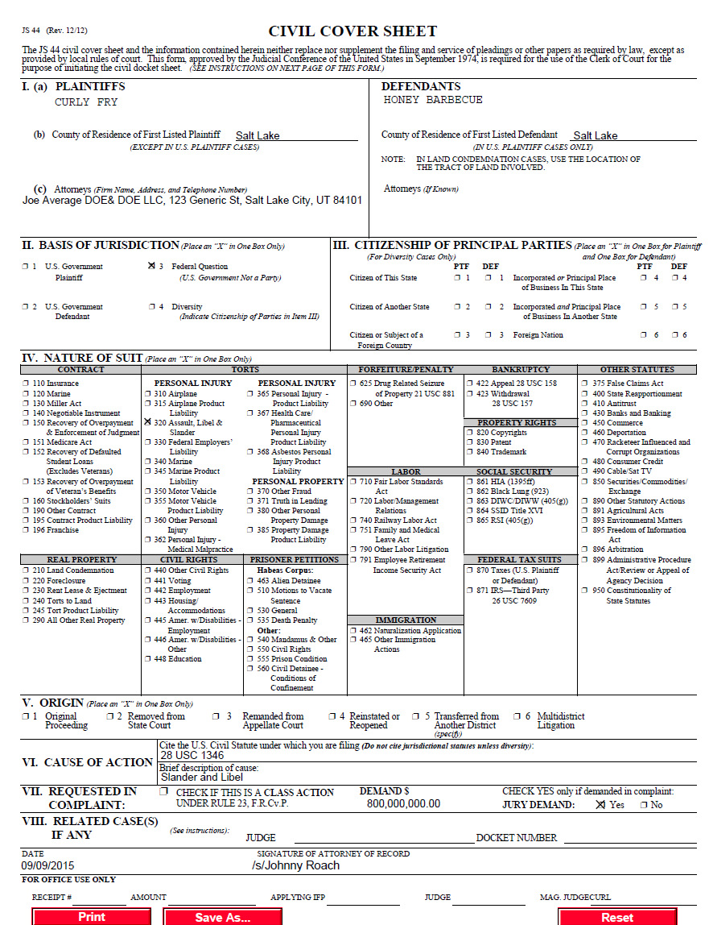
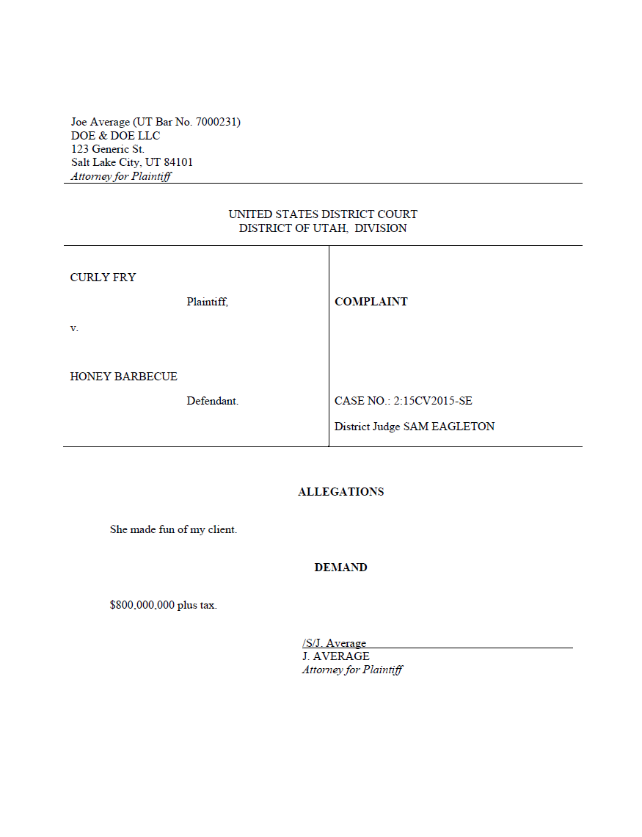
Filing a New Civil Case

Slide 18
Filing a New Civil Case
(Handout Initiating A New Civil Case)
  E-mail Complaint and Civil Cover Sheet in PDF format before 4:00 p.m. Monday - Friday. The clerk will not e-file the complaint.
  The clerk will create a “shell” case in the docket, entering the case information, assigning a judge and case number, and adding the parties.
  Emails received after 4:00 p.m. will not be opened until the next business morning.

Slide 19
Filing a New Civil Case
    The clerk’s office will enter a “Remark - New Case” event on the docket and a Notice of Electronic Filing (“NEF”) will be emailed to counsel. The NEF will instruct counsel to file the Complaint and pay the filing fee by the end of the business day. The filing fee is paid while in CM/ECF through Pay.gov.

Slide 20
Filing a New Civil Case (Cont’d)
    The attorney must file the initiating documents as soon as possible after receiving electronic notification that the case has been opened.
    The attorney has until 11:59 p.m. on the date of filing to pay and upload initiating documents.
    The case is not considered opened until the fee is paid. (Caution – if you pay the fee but don’t finish the filing, the case is not filed.)
    Summonses may be emailed to the clerk for electronic issuance once the case is filed. (see handout)

Slide 21
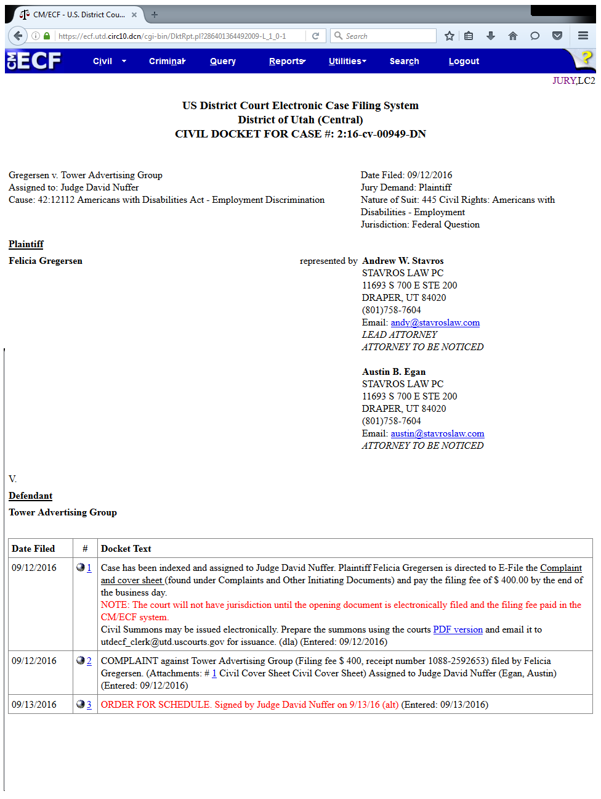

Slide 22
UNITED STATES DISTRICT COURT DISTRICT OF UTAH
CIVIL SUMMONS ISSUED ELECTRONICALLY
1. Counsel will prepare the civil summons using the court's PDF version located on the court's website at http://www.utd.uscourts.gov/forms/AO_440.pdf
(Note: do not use the WordPerfect version for an electronic summons)
2. Counsel will email the prepared summons to the clerk's office: utdecf_clerk@utd.uscourts.gov
3. The summons may be emailed to the clerk's office anytime after the complaint has been entered on the docket.

Slide 23
UNITED STATES DISTRICT COURT DISTRICT OF UTAH
CIVIL SUMMONS ISSUED ELECTRONICALLY
4. Once the complaint has been entered on the docket, the summons will be issued electronically by the clerk's office and entered on the docket. Access to this entry will be restricted to case participants.
5. Counsel will receive a NEF with a link to the electronic summons. To access the summons, the attorney will be required to enter their E-filing (not PACER) login to verify their identity. The summons may then be printed to use for service.

Slide 24
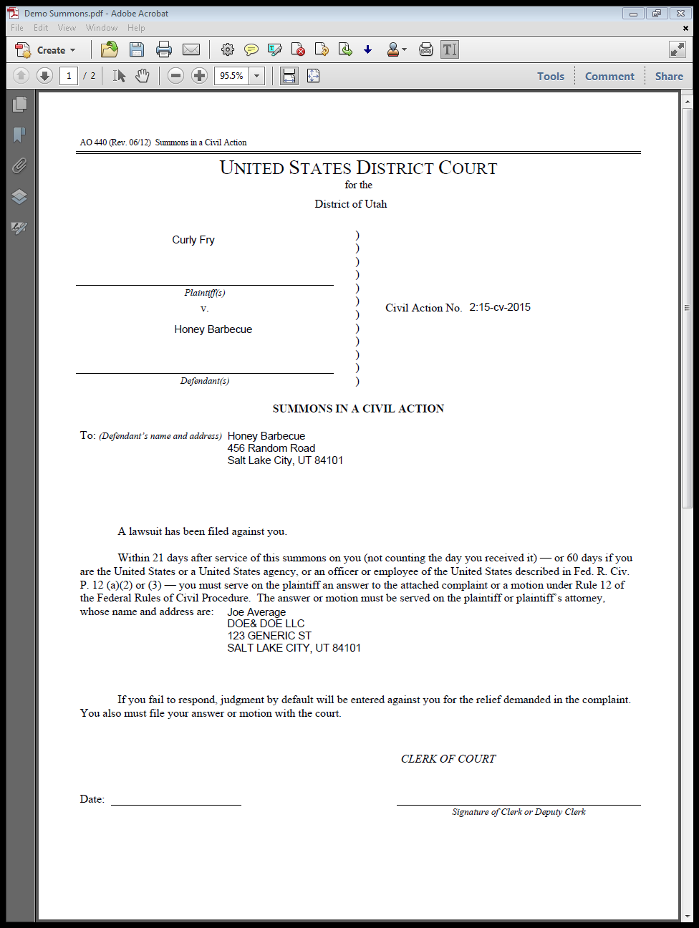
Summons PDF document emailed to clerk’s office.

Slide 25
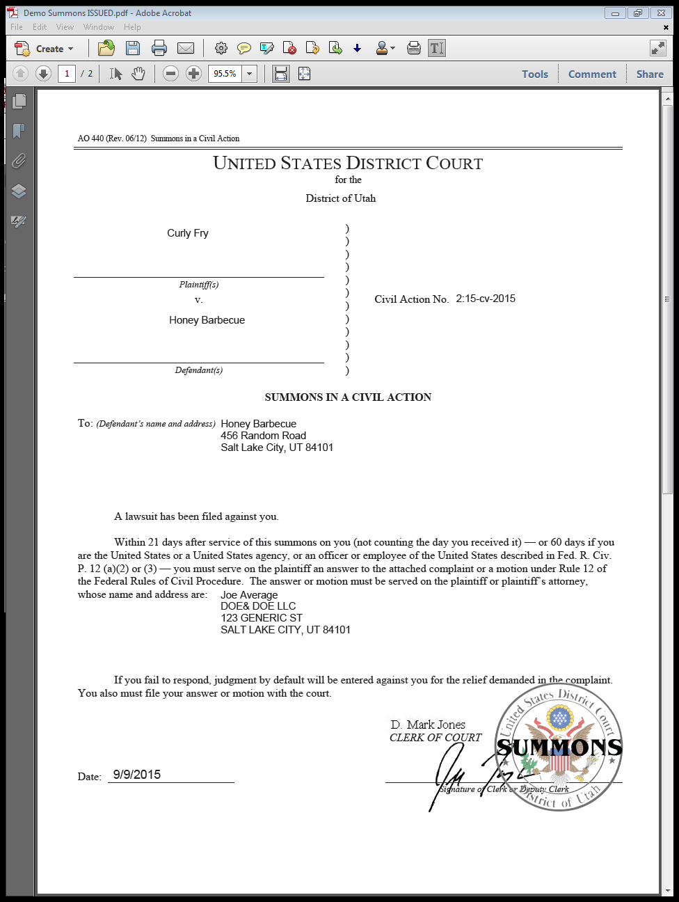
Electronically issued and entered on case docket
Per privacy policy, only counsel added to the case will have access to see the document.

Slide 26
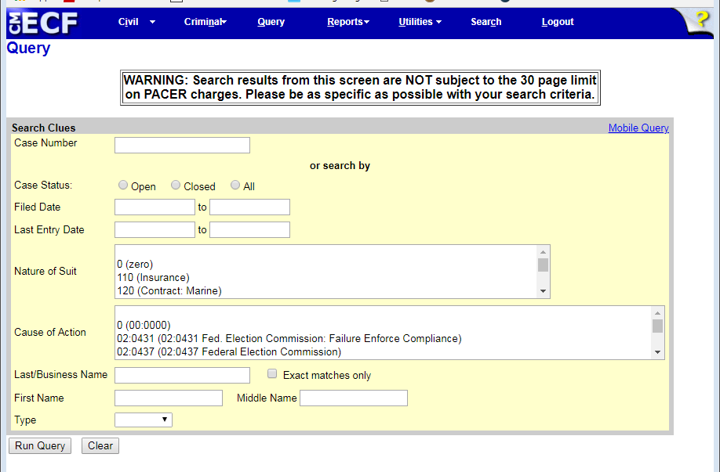
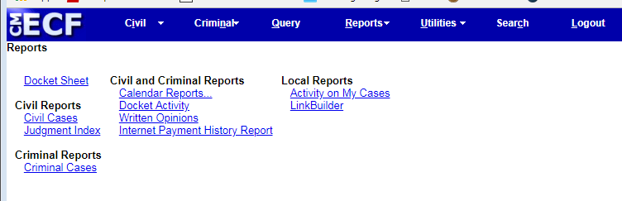
PACER DEMO

Slide 27
E-Filing Tips
How to Help Yourself

Slide 28
E-Filing Tips
Be prepared to e-file. Take the training, get your log in, be sure you keep your membership active.
Use the Search feature, or call the Help Desk.
Enter own appearance; do not file for other attorneys, unless you are on the case. Otherwise, you will be added to the case.
Use approved internet browsers (Internet Explorer, Firefox best; Google Chrome does not work well with CM/ECF)
Help Desk:
8:30 a.m. to 4:30 p.m.
801-524-6100

Slide 29
E-Filing Tips
Review your documents before filing.
Select only the parties you are filing for (e.g. – Stipulated Motion: only select party you represent).
Don’t scan documents if you can help it. Use word processor to create documents and convert to PDFs.
Exhibits – describe each attachment and keep them broken out into manageable sizes.

Slide 30
E-Filing Tips
Use hyperlinks – can link to case law, entries in your case or other cases, even an exhibit you are adding as an attachment.
Choose most specific filing event (i.e.: Motion for Extension of Time v. Motion for Extension of Time to File Response/Reply).
MOTIONS
  Any request/petition seeking action by the court should be filed as a Motion.
  Stipulations should be filed as Motions and you should add “Stipulated” into the text. Do not use the “Stipulation” event for motions.
  If requesting multiple or alternative reliefs, select all applicable motion types.

Slide 31
E-Filing Tips
Sealed Documents in Civil Cases
  New Addition to CM/ECF – implemented in December 2017
  File REDACTED version of document in CM/ECF.
  File Motion for Leave to File Sealed Document.
  File SEALED version of document in CM/ECF using Sealed Document event.
  Sealed documents will appear on the docket but will not be viewable on PACER.
  Filing a sealed document will trigger a NEF to be sent to all parties, but parties will not have access to sealed filings.
    Still need to serve other parties.

Slide 32
Practice Pointers
Filings, Rules, and Procedures

Slide 33
Federal Court Practice Pointers
Become familiar with the court’s website. (www.utd.uscourts.gov)
Read through the Federal Rules and the Local Rules. They change fairly often.
Stay on top of deadlines. Be familiar with response and reply deadlines, and pay attention to deadlines set in trial orders.
District judge, magistrate judge - who is assigned to your case and in what capacity? Send proposed orders to the appropriate chambers.

Slide 34
Federal Court Practice Pointers
Scheduling – contact the appropriate judge’s courtroom deputy clerk to schedule hearings.
Email with cc’s to all parties and make joint telephone calls as often as possible.
Motions – The court generally does not read motions until they are fully briefed.
Check the assigned judge’s practices and procedures on the court website. For example, some judges want paper courtesy copies and others do not.

Slide 35
Court Website
  Training and Reference Materials Always Available
  News and Announcements
  www.utd.uscourts.gov

Slide 36
Questions?

