Slide 1
The Future of the Fourth Amendment
David Nuffer

Slide 2
The right of the people to be secure in their persons, houses, papers, and effects, against unreasonable searches and seizures, shall not be violated,
and no Warrants shall issue, but upon probable cause, supported by Oath or affirmation, and particularly describing the place to be searched, and the persons or things to be seized.

Slide 3
Fourth Amendment History
1700s – mail regularly opened
1782 – first postal confidentiality law
1838 – telegraph
1876 – telephone

Slide 4
Fourth Amendment History
1890 – The Right to Privacy, Samuel D. Warren and Louis D. Brandeis
Recent inventions and business methods call attention to the next step which must be taken for the protection of the person, and for securing to the individual what Judge Cooley calls the right "to be let alone." Instantaneous photographs and newspaper enterprise have invaded the sacred precincts of private and domestic life; and numerous mechanical devices threaten to make good the prediction that "what is whispered in the closet shall be proclaimed from the house-tops." 4 Harv. L. Rev. 193, 195.
1890 – Wiretapping starts

Slide 5
Fourth Amendment History
1927 – U.S. v. Lee, 274 U.S. 559 Shining a deck-mounted spotlight onto the open deck of a vessel used for rum running did not constitute a “search”
1928 – Olmstead v. U.S., 277 U.S. 438 Interception of telephone communications not requiring a physical trespass not a search or sei­zure
1960 – Pen register technology
1967 – Katz v U.S., 389 U.S. 347 Interception of communications from a public out­door telephone booth requires a warrant

Slide 6
Fourth Amendment History
1968 – Omnibus Crime Control and Safe Streets Act requires wiretapping warrant
1976 – U.S. v Miller, 425 U.S. 435 Bank records subpoena not a search
1979 – Smith v Maryland, 442 U.S. 735 Pen register not a search
1994-95 – Thermal imaging without warrant upheld by 7th 8th 11th circuits
2001 – Kyllo v U.S., 533 U.S. 27 Warrant required for thermal imaging
2012 – United States v. Jones, 132 S. Ct. 945 Placement of GPS tracking device on a vehicle and subsequent monitoring is a search
2014 - Riley v California, US v Wurie Cell phone cannot be searched routinely incident to arrest.

Slide 7
Judicial Analysis
“reasonable expectation of privacy” Katz v. United States, 389 U.S. 347, 360-61 (1967) (Harlan, J., concurring).
Exceptions:
assumption of risk: information revealed to a third party Smith v. Maryland, 442 U.S. 735, 744 (1979)
what a person knowingly exposes to the public U. S. v Miller, 425 U.S. 435 at 442-43
technology in general public use Kyllo v. United States, 533 U.S. 27 (2001); Dow Chem. Co. v. United States, 476 U.S. 227 (1986)

Slide 8
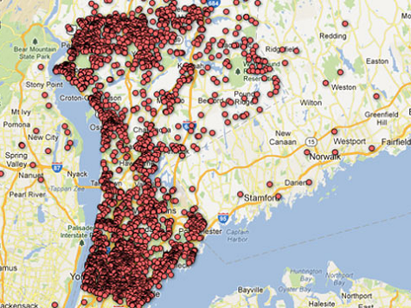
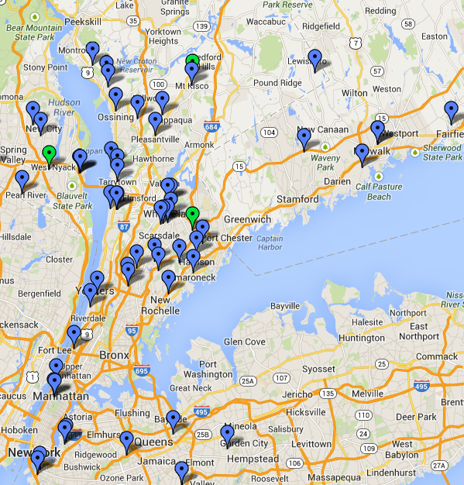
In the aftermath of the Sandy Hook shootings, a local newspaper published a map of homes of neighborhood gun owners.
In response, gun owners published a map marking the homes of the journalists who wrote for that paper.
http://www.newrochelletalk.com/content/map-where-are-journal-news-employees-your-neighborhood
http://www.complex.com/tech/2012/12/local-newspaper-posts-an-interactive-map-of-gun-owners-names

Slide 9
Current Fourth Amendment doctrine—premised on the reasonable expectation of privacy test and elaborated through principles such as assumption of risk, knowing exposure, and general public use—places far fewer hurdles in front of the police when they use the fruits of somebody else’s surveillance than when they do the surveillance themselves.
Does the “right of the people to be secure in their persons, houses, papers, and effects, against unreasonable searches and seizures” survive once the police can request from the private sector the fruits of comprehensive, consensual private surveillance?
Private industry is destined to become the unwitting research and development arm of the FBI.
Paul Ohm, The Fourth Amendment in a World Without Privacy, 81 Miss. L. J. 1309 (2012)
http://www.olemiss.edu/depts/ncjrl/FourthAmendment/fai_2011symposia.html

Slide 10
Incursions
Commercial
Workplace
Stealth

Slide 11
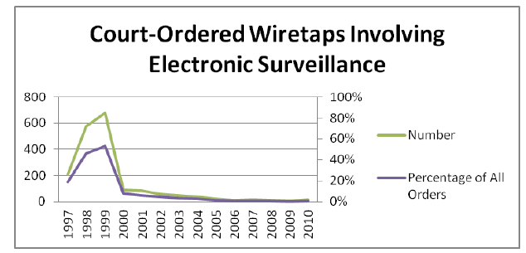
Paul Ohm, The Fourth Amendment in a World Without Privacy, 81 Miss. L. J. 1309 (2012)
http://www.olemiss.edu/depts/ncjrl/FourthAmendment/fai_2011symposia.html
Notes:
Ohm at 1323

Slide 12
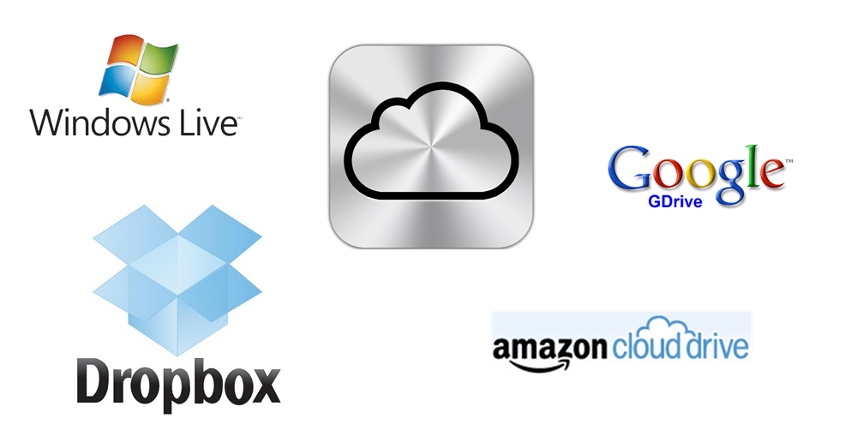

Slide 13
We won't share Snapshot information unless it's required to service your insurance policy, prevent fraud, perform research or comply with the law.

Slide 14
Target assigns every customer a Guest ID number, tied to their credit card, name, or email address that becomes a bucket that stores a history of everything they’ve bought and
any demographic information Target has collected
from them or bought from other sources.
Kashmir Hill, Forbes, February 16, 2012
How Target Figured Out A Teen Girl Was Pregnant Before Her Father Did
The marketers said they wanted to send specially
designed ads to women in their second trimester, which is when most expectant mothers begin buying
all sorts of new things, like prenatal vitamins and
maternity clothing. “We knew that if we could
identify them in their second trimester, there’s a
good chance we could capture them for years.”
Charles Duhigg, New York Times, February 16, 2012 How Companies Learn Your Secrets

Slide 15
Women on the baby registry were buying larger quantities of unscented lotion around the
beginning of their second trimester. Another
analyst noted that sometime in the first 20 weeks,
pregnant women loaded up on supplements like
calcium, magnesium and zinc. Many shoppers
purchase soap and cotton balls, but when someone
suddenly starts buying lots of scent-free soap and
extra-big bags of cotton balls, in addition to hand
sanitizers and washcloths, it signals they could be
getting close to their delivery date.
Charles Duhigg, New York Times, February 16, 2012
How Companies Learn Your Secrets

Slide 16
A man walked into a Target outside Minneapolis and demanded to see the manager. He was clutching coupons that had been sent to his daughter, and he was angry . . . .
“My daughter got this in the mail!” he said. “She’s still in high school, and you’re sending her coupons for baby clothes and cribs? Are you trying to encourage her to get pregnant?”
The manager didn’t have any idea what the man was talking about. He looked at the mailer. Sure enough, it was addressed to the man’s daughter and contained advertisements for maternity clothing, nursery furniture and pictures of smiling infants. The manager apologized and then called a few days later to apologize again.
On the phone, though, the father was somewhat abashed. “I had a talk with my daughter,” he said. “It turns out there’s been some activities in my house I haven’t been completely aware of. She’s due in August. I owe you an apology.”
Charles Duhigg, New York Times February 16, 2012 How Companies Learn Your Secrets

Slide 17
“With the pregnancy products, though, we learned that some women react badly,” the executive said. “Then we started mixing in all these ads for things we knew pregnant women would never buy, so the baby ads looked random. We’d put an ad for a lawn mower next to diapers. We’d put a coupon for wineglasses next to infant clothes. That way, it looked like all the products were chosen by chance.”
“And we found out that as long as a pregnant woman thinks she hasn’t been spied on, she’ll use the coupons. She just assumes that everyone else on her block got the same mailer for diapers and cribs. As long as we don’t spook her, it works.”
Charles Duhigg, New York Times, February 16, 2012 How Companies Learn Your Secrets

Slide 18
“Just wait. We’ll be sending you coupons for things you want before you even know you want them.”
When I offered to fly to Target’s headquarters to discuss its concerns, a spokeswoman e-mailed that no one would meet me. When I flew out anyway, I was told I was on a list of prohibited visitors. “I’ve been instructed not to give you access and to ask you to leave,” said a very nice security guard named Alex.
Charles Duhigg, New York Times, February 16, 2012 How Companies Learn Your Secrets

Slide 19
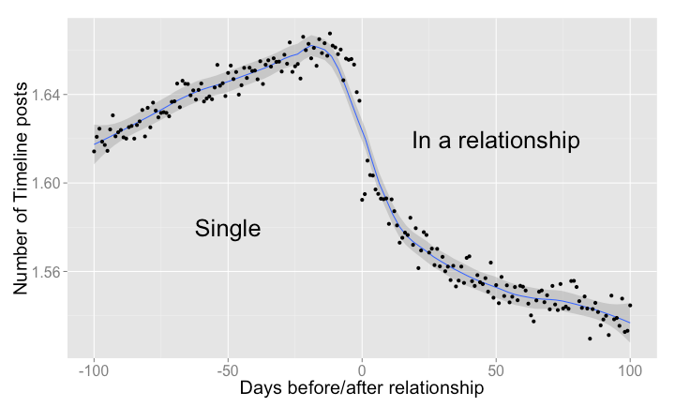
https://www.facebook.com/notes/facebook-data-science/the-formation-of-love/10152064609253859
Notes:
We observe a peak of 1.67 posts per day 12 days before the relationship begins, and a lowest point of 1.53 posts per day 85 days into the relationship. Presumably, couples decide to spend more time together, courtship is off, and online interactions give way to more interactions in the physical world.
This is based on 460 thousand couples, and 18 million posts
https://www.facebook.com/notes/facebook-data-science/the-formation-of-love/10152064609253859

Slide 20
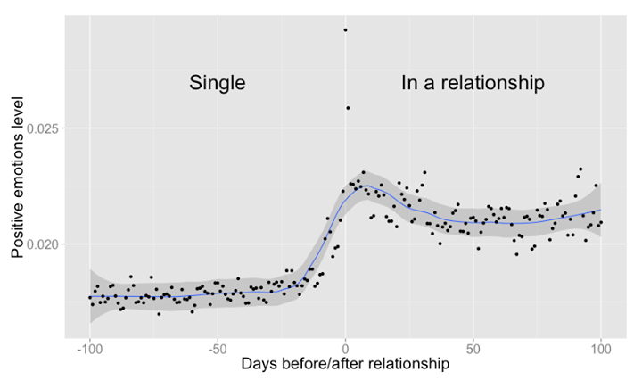
https://www.facebook.com/notes/facebook-data-science/the-formation-of-love/10152064609253859
Notes:
For each timeline interaction, we counted the proportion of words expressing positive emotions (like "love", "nice", "happy", etc.) minus the proportion of words expressing negative ones (like "hate", "hurt", "bad", etc.).
Comment: una prueba mas indicando que facebook monitorea y espia todas las conversaciones de sus usuarios
https://www.facebook.com/notes/facebook-data-science/the-formation-of-love/10152064609253859

Slide 21
Facebook makes money by selling ad space to companies that want to reach us. Advertisers choose key words or details — like relationship status, location, activities, favorite books and employment — and then Facebook runs the ads for the targeted subset of its 845 million users. If you indicate that you like cupcakes, live in a certain neighborhood and have invited friends over, expect an ad from a nearby bakery to appear on your page.
Lori Andrews, Facebook Is Using You New York Times, February 4, 2012
The most important thing to understand about Facebook is that you are not Facebook’s customer, you are its inventory. You are the product Facebook is selling. Facebook’s real customers are advertisers. You, as a Facebook member, are useful only because you can be packaged up and sold to advertisers.
Daniel Lyons, Online Privacy: Who Needs Friends Like Facebook? Newsweek, March 23, 2010

Slide 22
If you’ve mentioned anxiety in an e-mail, done a Google search for “stress” or started using an online medical diary that lets you monitor your mood, expect ads for medications and services to treat your anxiety.
Lori Andrews, Facebook Is Using You New York Times, February 4, 2012
When an Atlanta man returned from his honeymoon, he found that his credit limit had been lowered to $3,800 from $10,800. The switch was not based on anything he had done but on aggregate data. A letter from the company told him, “Other customers who have used their card at establishments where you recently shopped have a poor repayment history with American Express.”
Lori Andrews, Facebook Is Using You New York Times, February 4, 2012

Slide 23
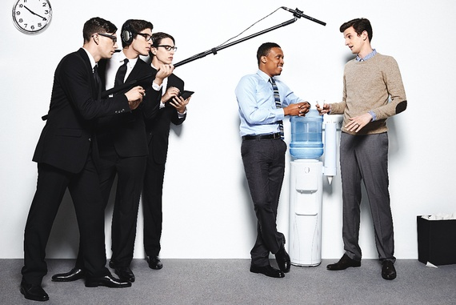
Workplace Data Collection and Analytics
Don Peck, They're Watching You at Work The Atlantic, November 20 2013

Slide 24
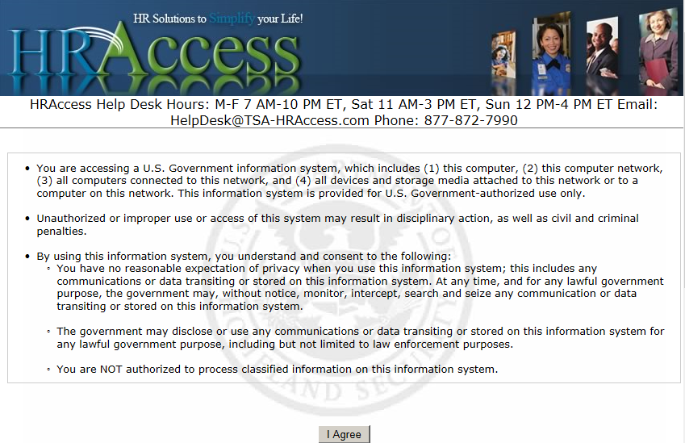

Slide 25
You have no reasonable expectation of privacy when you use this information system; this includes any communications or data transiting or stored on this information system. At any time, and for any lawful government purpose, the government may, without notice, monitor, intercept, search and seize any communication or data transiting or stored on this information system.
The government may disclose or use any communications or data transiting or stored on this information system for any lawful government purpose, including but not limited to law enforcement purposes.

Slide 26
Evolv
captures data about everybody who applies for work and everybody who gets hired
In the US, doesn’t use neighborhood, marital status, parenthood, church membership – but overseas use of this data yields “startling results”
Evolv can say with precision which attributes matter more to the success of retail sales workers (decisiveness, spatial orientation, persuasiveness) or customer-service personnel at call centers (rapport-building)
Don Peck, They're Watching You at Work The Atlantic, November 20 2013
Notes:
http://www.evolv.net/

Slide 27
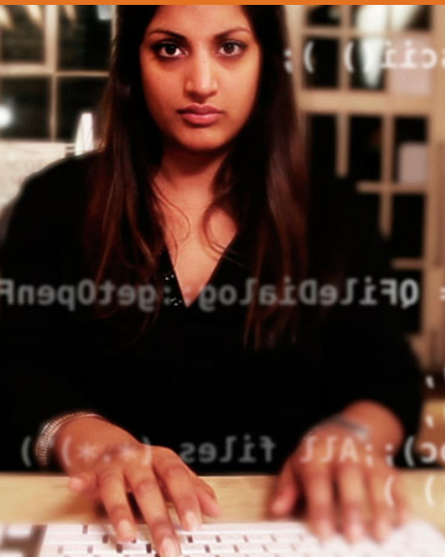
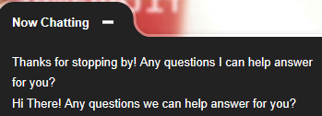
Gild
6 million programmers in its database
Scours the web for source code
Evaluates for simplicity, elegance, documentation, frequency of adoption by others, completion times
How popular is coder’s advice on social forums?
“Words and phrases on social networks can distinguish expert programmers”
“One solid predictor of strong coding is an affinity for a particular Japanese manga site.”
Don Peck, They're Watching You at Work The Atlantic, November 20 2013
Notes:
http://www.gild.com/

Slide 28
Knack
App based video games designed by data scientists, neuroscientists, psychologists
Play 20 minutes
Measure: Hesitation, sequence of action, solutions found
Verify creativity, persistence, learning ability, prioritization, social intelligence
One client with a database of all the ideas it had received, initially funded, further funded, and marketed tested 1,400 idea contributors. The top 10 percent of the idea generators as predicted by Knack were in fact those who’d gone furthest in the process.
Don Peck, They're Watching You at Work The Atlantic , November 20 2013
Notes:
http://knack.it/about/

Slide 30
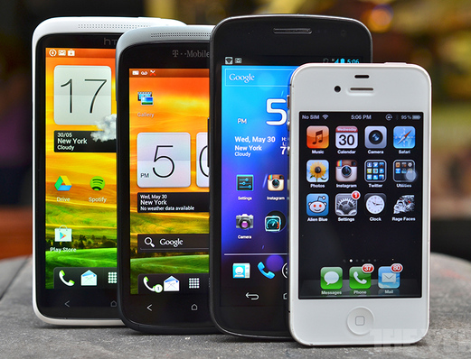
Notes:
http://www.theverge.com/2013/4/26/4268982/idc-q1-2013-smartphone-market-data
http://collaborativeservicesinc.wordpress.com/2013/07/18/ask-me-3-and-if-you-still-dont-understand-ask-some-more/

Slide 31
Email
Messaging
GPS
Contacts
Calendar
Passwords
Web browsing
App data
Cloud storage
Photos (geolocation)
If it matters to me,
it is on my phone.
Notes:
http://www.theverge.com/2013/4/26/4268982/idc-q1-2013-smartphone-market-data
http://collaborativeservicesinc.wordpress.com/2013/07/18/ask-me-3-and-if-you-still-dont-understand-ask-some-more/

Slide 32
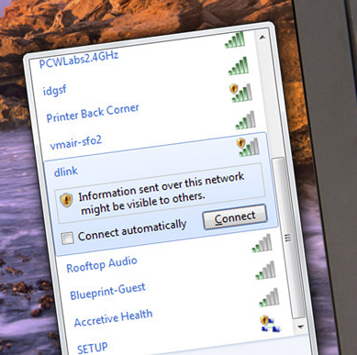
It’s similar to listening in on someone’s CB or walkie-talkie radio conversation. Like CBs and walkie-talkies, Wi-Fi networks operate on public airwaves that anyone nearby can tune into.
MAC address
User name
Web pages
Messages
Account logins
Eric Geier, Here's what an eavesdropper sees when you use an unsecured Wi-Fi hotspot PC World, June 28, 2013

Slide 33
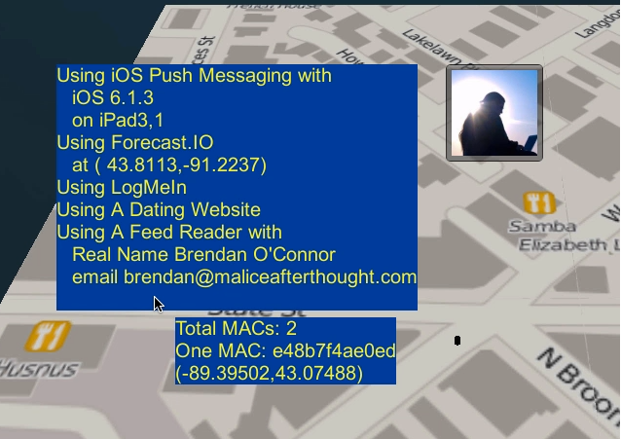
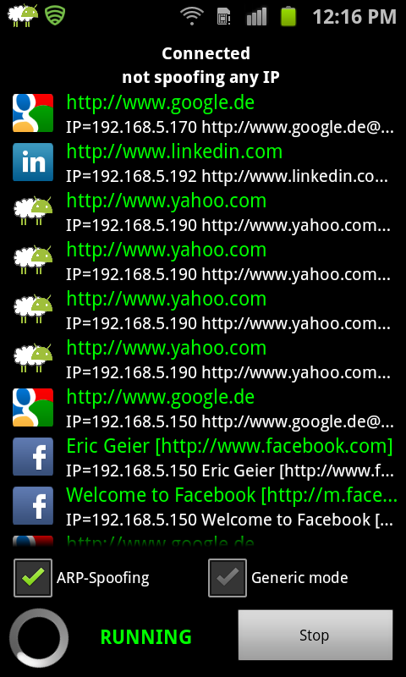
Eric Geier, Here's what an eavesdropper sees when you use an unsecured Wi-Fi hotspot PC World, June 28, 2013
Notes:
Once I’d done that, I could magically access my Facebook account on that rooted Android phone (see the screen at lower right) without ever providing my username or password from that device

Slide 34
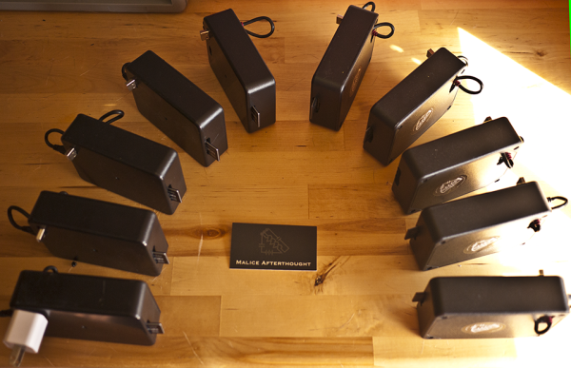
http://arstechnica.com/security/2013/08/diy-stalker-boxes-spy-on-wi-fi-users-cheaply-and-with-maximum-creep-value/#p3
Notes:
http://arstechnica.com/security/2013/08/diy-stalker-boxes-spy-on-wi-fi-users-cheaply-and-with-maximum-creep-value/#p3
Creepy Distributed Object Locator, CreepyDOL is the brainchild of 27-year-old Brendan O'Connor, a law student at the University of Wisconsin at Madison and a researcher at a consultancy called Malice Afterthought. Every couple of seconds, every wireless device that's on is sending out a huge amount of personally identifiable information. If we have sensors spread out over an area, that means it's sending out both an identifier and its location." "It takes you five seconds to bring your VPN online," he said. "During that time, iMessage has already pinged for updates, Dropbox has already pinged for updates, your mail client has already pinged for updates. Other data CreepyDOL can mine includes the apple hardware identifier (model and version) and iOS version he uses. And even when people use their mobile devices to connect only to password-protected Wi-Fi networks, there's still a fair amount of data CreepyDOL can collect. That's because the Wi-Fi protocol broadcasts MAC addresses, the names of recently connected networks, and other data whenever Wi-Fi is turned on. At a minimum, that's enough information to track the physical movement of specific devices through a neighborhood or entire city over an extended period of time.

Slide 35
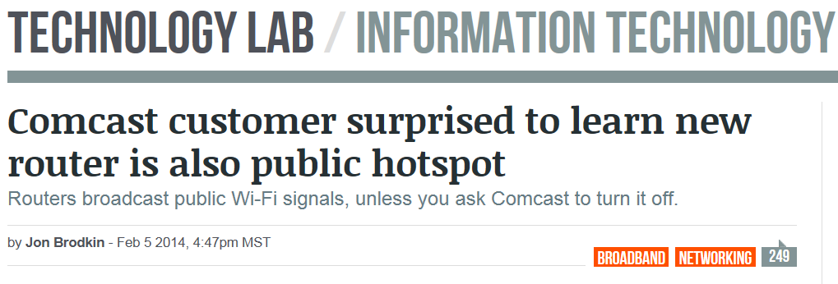
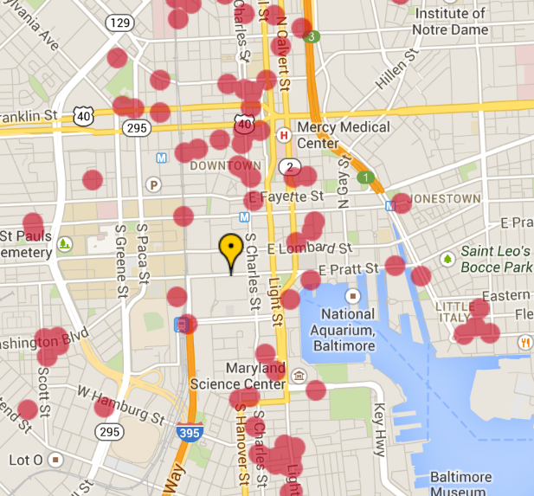
http://arstechnica.com/information-technology/2014/02/comcast-customer-surprised-to-learn-new-router-is-also-public-hotspot/

Slide 36
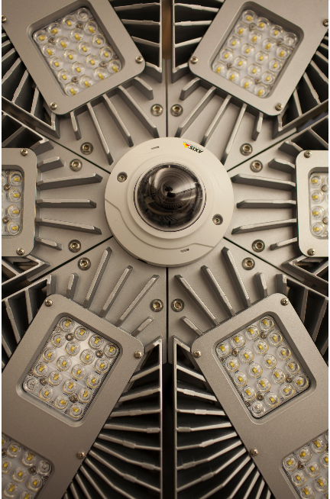
At Terminal B at Newark Liberty International Airport, 171 recently installed LED fixtures and eight video cameras are part of a new wireless network that collects and feeds data into software that can spot long lines, recognize license plates and even identify suspicious activity, sending alerts to the appropriate staff.
Data that is collected -- say, a particular car pulling up to the terminal -- can then be mined and analyzed for a broad range of applications.
Diane Cardwell, At Newark Airport, the Lights Are On, and They're Watching You New York Times, February 18, 2014

Slide 37
Privacy Not The Standard?
In a world without privacy, a Fourth Amendment focused on privacy becomes nearly a dead letter. Today’s Fourth Amendment has been built around the reasonable expectation of privacy test, but no expectation of privacy will be deemed reasonable in a world without privacy.
Paul Ohm, The Fourth Amendment In A World Without Privacy, 81 Miss. L. J. 1309 (2012)
http://www.olemiss.edu/depts/ncjrl/FourthAmendment/fai_2011symposia.html

Slide 38
Judicial and Legislative Delays
Wiretapping
1890 – technology
1934 – Communications Act
1967 – Katz
Bugging
1956-71 – COINTELPRO
1986 – ECPA
Pen register
1960 – technology
1979 – Smith v Maryland
Thermal scanning
1980 – technology
1994-95 – 7th, 8th 11th Circuits approve
2001 – Kyllo (1992 violation)
Corrine Birrell, Technology and the Fourth Amendment: Balancing Law Enforcement with Individual Privacy

Slide 39
Bad Analogies
In rejecting Fourth Amendment claims involving warrantless use of sophisticated technologies, courts often rely upon analogies to prior “search” cases, but these supposed analogies are so far removed from the new forms of surveillance that analogies to them only confuse, rather than clarify . . . .
Marc McAllister, The Fourth Amendment and New Technologies: The Misapplication of Analogical Reasoning, 36 So. Ill. U. L. J. 475, 477 (2012).

Slide 40
Bad Analogies
Bugging and eavesdropping - Lee v. U.S. (1952)
Aerial surveillance and open fields – Dow Chemical (1986)
Abandoned DNA and trash and– People v. Gallego (Cal. Ct. App. 2010)
Tracking devices and visual surveillance – U.S. v. Knotts (1983) (overruled by U.S. v. Jones (2012).
Email, web sites and pen registers – U.S. v. Forrester (9th Cir. 2007)

Slide 41
Current Challenges to Privacy
Pervasive use of electronic transactions and communication
Commercial data collection
Workplace collection
Stealth data collection– private and governmental
Defective legal responses
No proactive policy analysis, legislation and regulation
Delay inherent in judicial process
Precedent – factual analogies rather than policy
National security overrides
Rogue government actions
Notes:
Secrecy trumps privacy

Slide 42
Processing Threats
Data volume and low cost of storage
Automated analytics
Data aggregation, repurposing and sharing

Slide 43
“Everyone has the right to respect for his private and family life, his home and his correspondence.”
Article 8 of the European Convention for the Protection of Human Rights and Fundamental Freedoms
http://www.coe.int/t/dghl/standardsetting/DataProtection/TPD_documents/Handbook.pdf

Slide 44
The right of the people to be secure in their persons, houses, papers, and effects, against unreasonable searches and seizures, shall not be violated,
and no Warrants shall issue, but upon probable cause, supported by Oath or affirmation, and particularly describing the place to be searched, and the persons or things to be seized.

Slide 45
New Hope – Riley / Wurie 2014
9-0 – no cell phone search incident to arrest (SITA)
Zero based examination
1761 speech of John Otis on general warrants
Reasonableness is the touchstone of the Fourth Amendment
Balance degree of intrusion on privacy against government interests
Holds to Chimel safety and evidence destruction foundations of the SITA exception.
Court shows tech knowledge
Massive amounts and types of data and apps
Rejected the risk of remote wiping
Discussed cloud implications
Rejected bad analogies – and added a new one
Cannot compare a ride on horseback and trip to the moon

Slide 46
Strategies
Careful analysis
New theories
Imaginative advocacy
Fact and technology specific arguments
Support for comprehensive policy
Notes:
Strategies to articulate policies that make sense in this age:

Slide 47
The Future of the Fourth Amendment
David Nuffer

