Slide 1
Using Technology to Convince -- And Not Distract -- a Judge and Jury
Utah Federal Bar
Salt Lake City
April 18, 2013
This PowerPoint presentation and the accompanying handout are both found at http://www.utd.uscourts.gov/judges/nuffer_resources.htm#Continuing

Slide 2
Education
Engagement
Delivery
Content

Slide 3
Barriers to Engagement
Time pressure
Distractions
Prior experience – or inexperience
Skepticism
Notes:
How do we defuse these barriers?

Slide 4
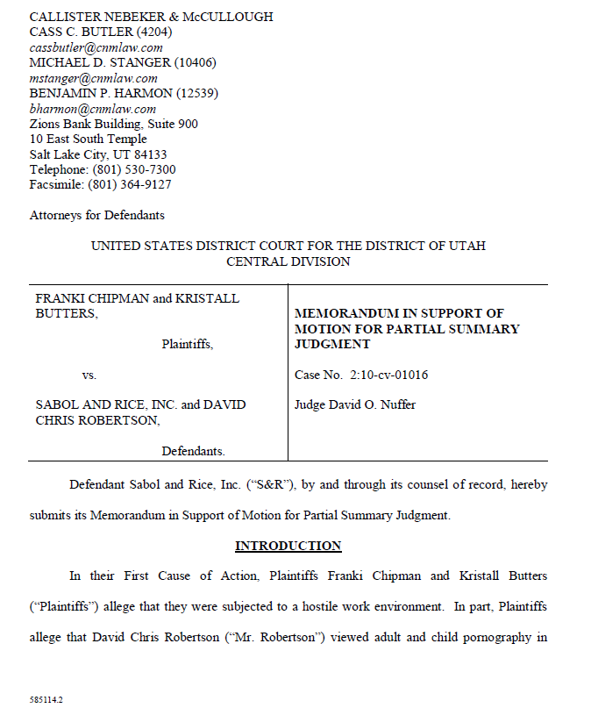
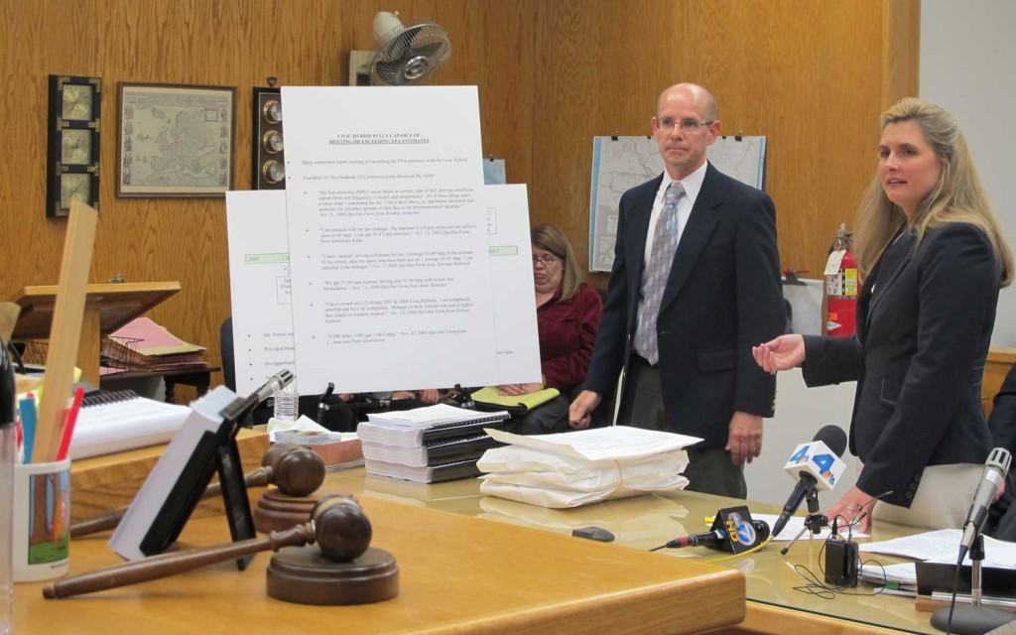
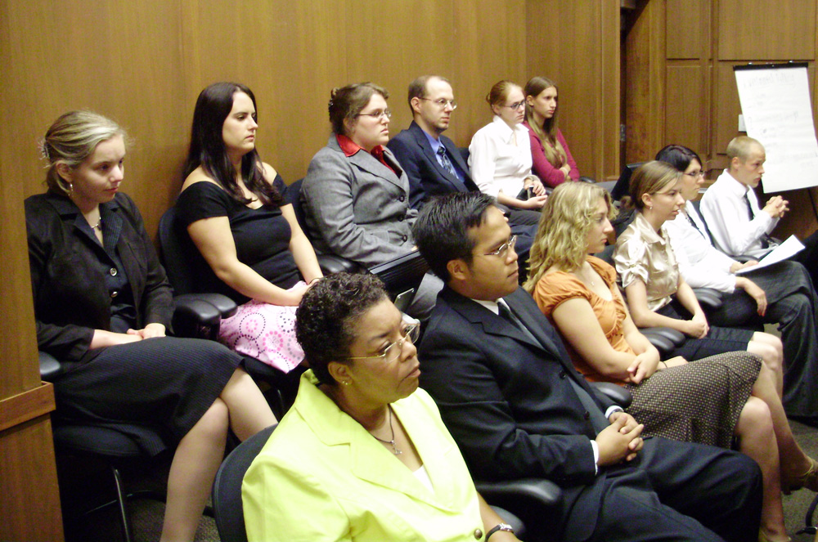
Opportunities for Persuasion

Slide 5
Written Submission Goals
Excellent content, delivery and engagement:
No sense of time pressure – “it’s not difficult”
No distractions
Information, to overcome listener’s prior experience – or inexperience
Credibility, to overcome skepticism

Slide 6
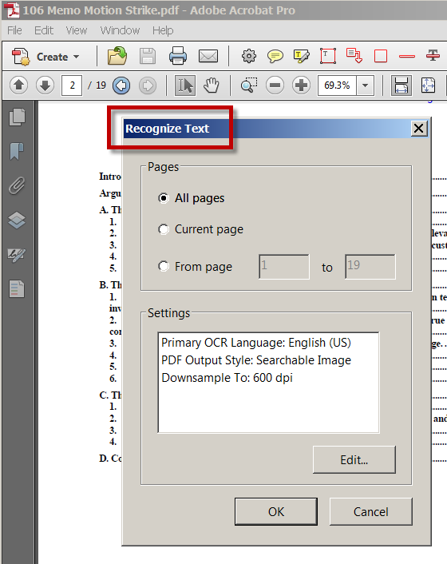
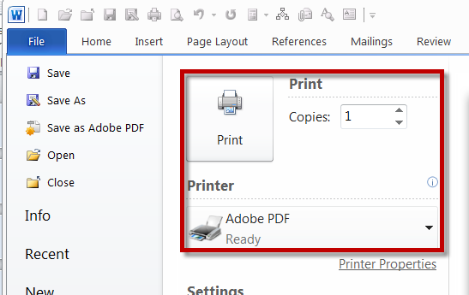
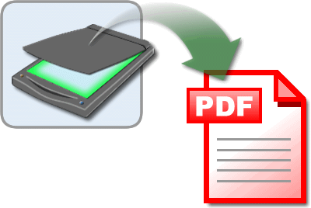
Technology in Writing
1. Finished PDF document must be entirely text-based to facilitate searching, copying, highlighting
Computer created documents output to PDF
Scanned attachments OCR’d

Slide 7
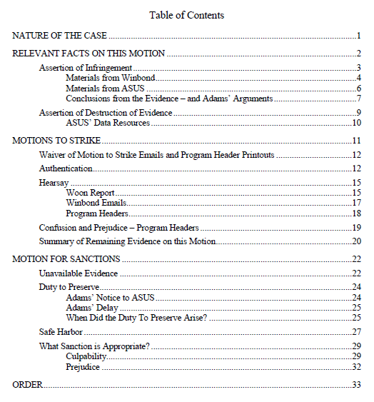
Technology in Writing
2. Begin with an outline, that becomes a table of contents.

Slide 8
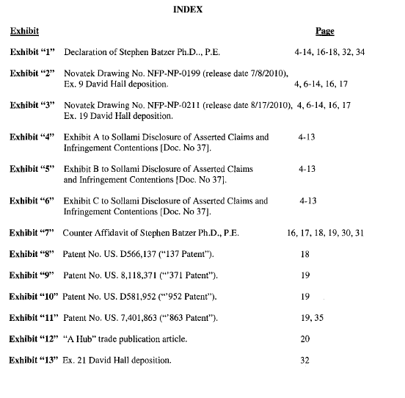
Technology in Writing
3. Create a List of Exhibits

Slide 9
Technology in Writing
4. Use Photos and Diagrams

Slide 10
Technology in Writing
5. Use Permissible Hyperlinks
Internal links – TOC and references
Research links – BriefSuite and LexLink
Document to Document links

Slide 11
http://www.utd.uscourts.gov/judges/nuffer_resources.htm#E-Research

Slide 12
DUCivR 7-5 HYPERLINKS IN COURT FILINGS
(a) Permissible and Impermissible Hyperlinks.
As a convenience for the court, practitioners are encouraged to utilize hyperlinks in a manner consistent with this rule.

Slide 13
DUCivR 7-5 HYPERLINKS IN COURT FILINGS
(1) Permissible Hyperlinks.
(A) A hyperlink to other portion of the same document and material elsewhere in the record, such as exhibits or deposition testimony, is permissible. (B) A hyperlink to an internet resource containing legal authority from recognized electronic research services, such as Westlaw, Lexis/Nexis or Findlaw and governmental rules and regulations, is permissible.

Slide 14
DUCivR 7-5 HYPERLINKS IN COURT FILINGS
(2) Impermissible Hyperlinks. A hyperlink to any other internet resource . . . is impermissible and the content of such an internet resource shall not be part of the record. . . .
[File] the material as an exhibit or by filing a Notice of Conventional Filing . . . and filing a copy . . . in PDF format.

Slide 15
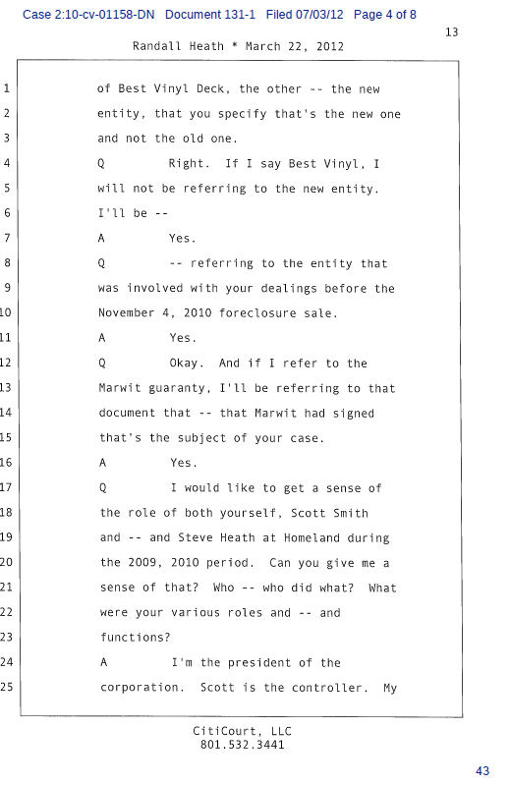
Technology in Writing
6. Deposition attachments in text-based PDF format
Output from word processing or text file
OCR if scanned in (high quality scan)

Slide 16
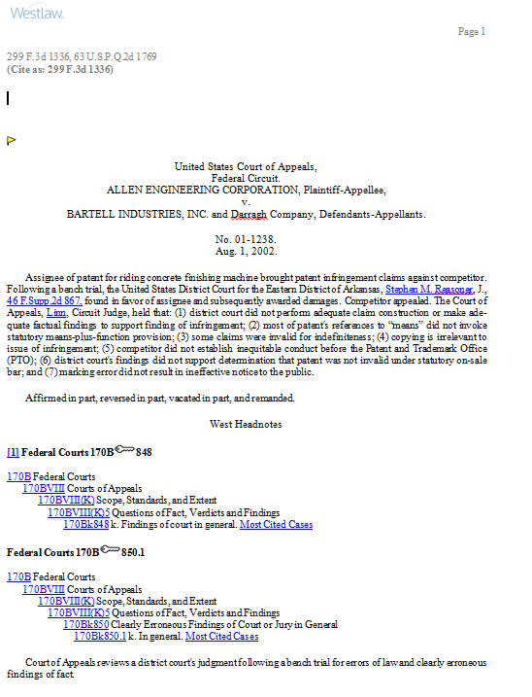
Technology in Writing
7. Opinion attachments in single column format (text based)

Slide 17
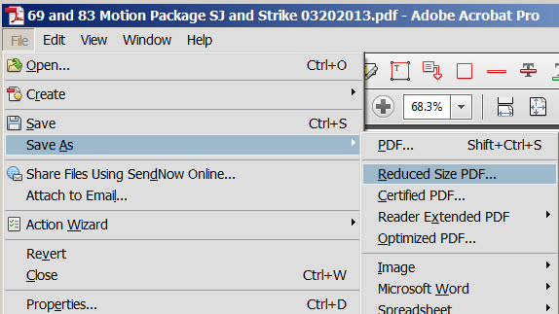
Technology in Writing
8. Save As Reduced Size PDF

Slide 18
Technology in Writing
9. Attach proposed order in PDF format – and email in word processing format to chambers.
Proposed orders [etc.] shall be (i) prepared as word processing documents; (ii) saved in WordPerfect or Word format, and (iii) transmitted to the assigned judge via email. . . .
An additional copy . . . shall be saved as a PDF file and filed electronically as an attachment to the motion . . . Admin E-Filing Procedures II. G. 1.

Slide 19
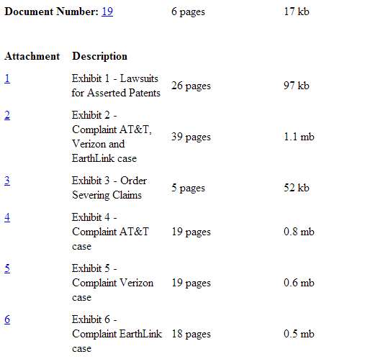
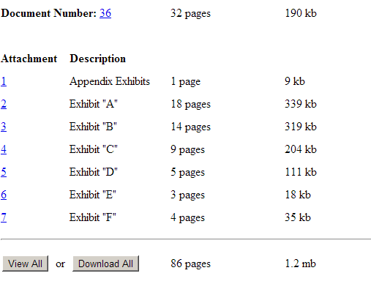
Technology in Writing
10. File attachments individually, with full descriptions

Slide 20
Hearing Goals
Excellent content, delivery and engagement

Slide 21
Technology in Hearings
Make a great transcript
(See court reporters’ hints)
http://www.utd.uscourts.gov/judges/nuffer_resources.htm#Continuing

Slide 22
Technology in Hearings
2. Consider Real Time Reporting for a client with a disability or language barrier.

Slide 23
Technology in Hearings
3. Submit summaries to the court in word processing format
Patent claim construction charts
Discovery dispute summaries
Deposition designation form
Exhibit and Witness Lists
Proposed Jury Voir Dire, Instructions and Verdict

Slide 24
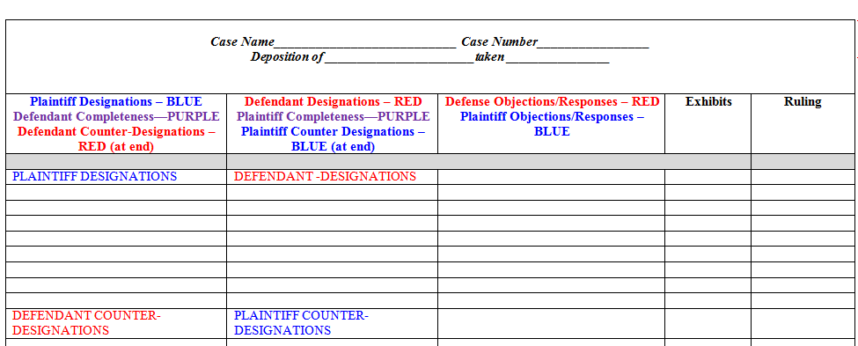

Slide 25
Technology in Hearings
4. Bring tangible objects

Slide 26
Technology in Hearings
5. Use Powerpoint CAREFULLY

Slide 27
Technology in Hearings
6. Audio Conferencing etiquette
Headset!
Speaker phone (mute)
No cell phones
Give name when speaking
Pause regularly

Slide 28
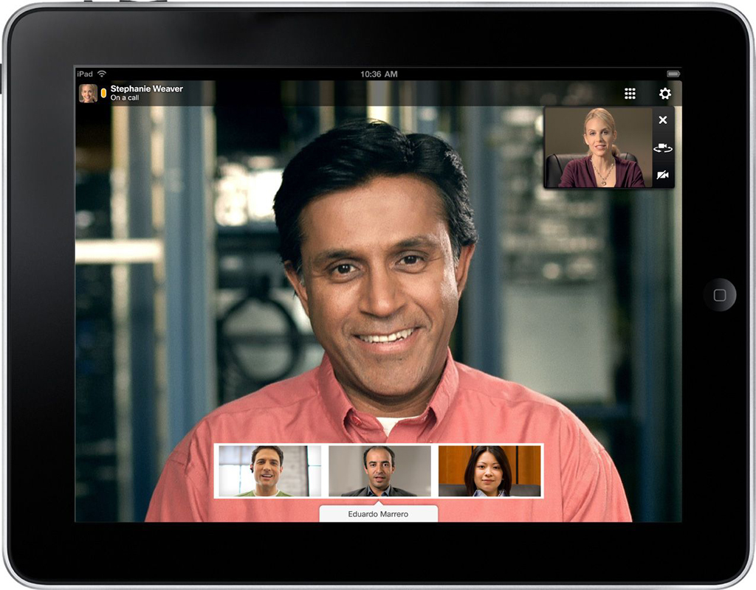
Technology in Hearings
7. Video Conferencing is coming
Based on Cisco Jabber Video for TelePresence
National Video Conference Bridge
H.323 systems and PC, Mac, iOS supported

Slide 29
Technology at Trial

Slide 30
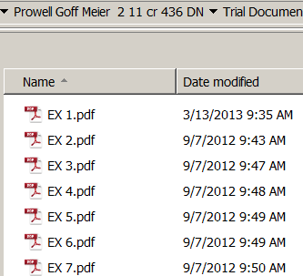
Technology at Trial
1. Prepare exhibits in text-based PDF format and provide to the court in advance

Slide 31
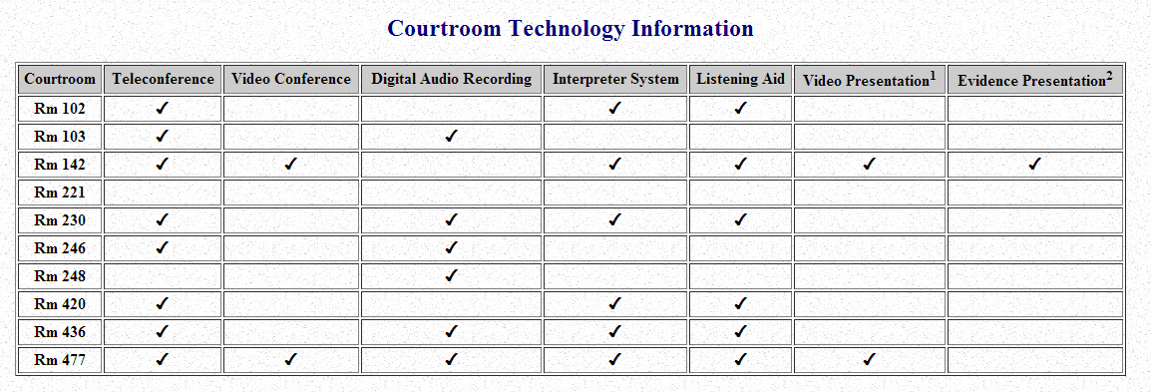
Technology at Trial
2. Verify Available Courtroom Technology
http://www.utd.uscourts.gov/documents/CourtroomTechnology.html

Slide 32
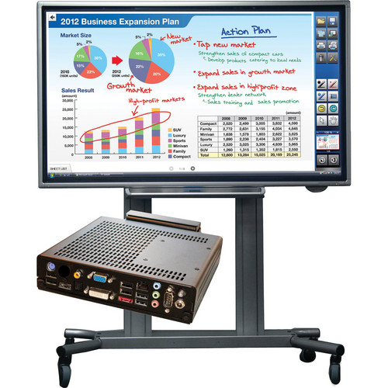

Slide 33
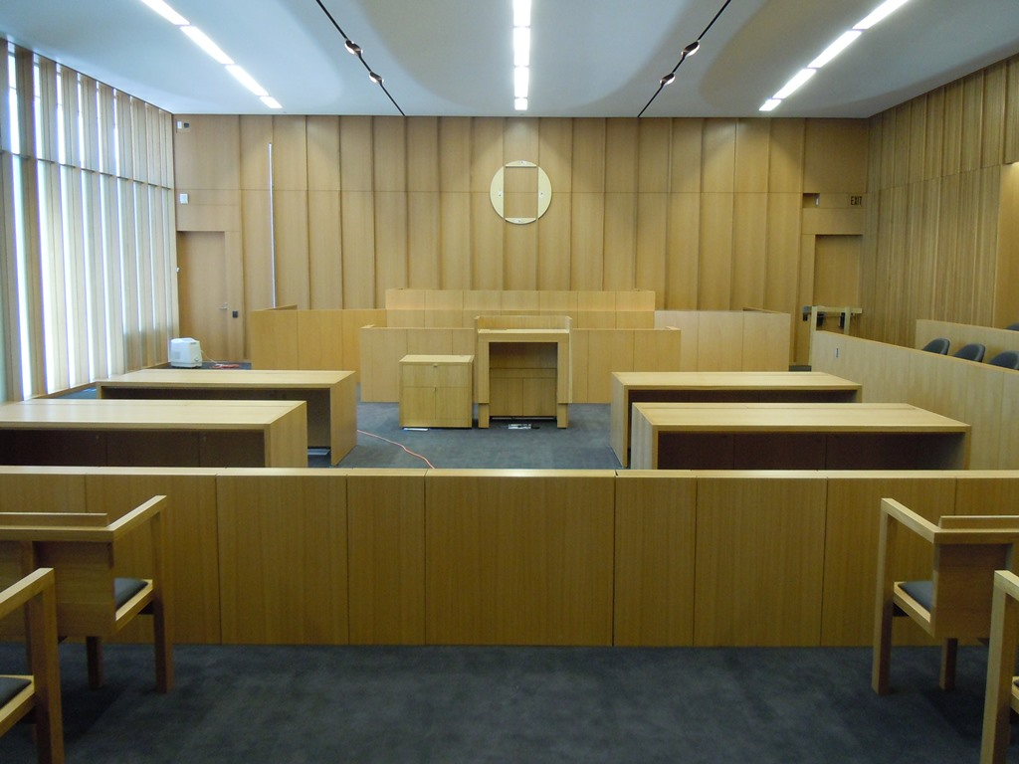

Slide 34
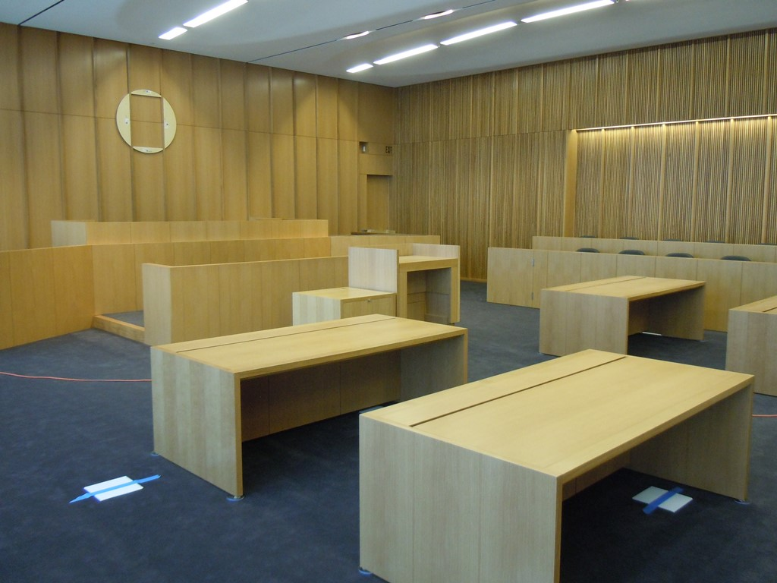

Slide 35
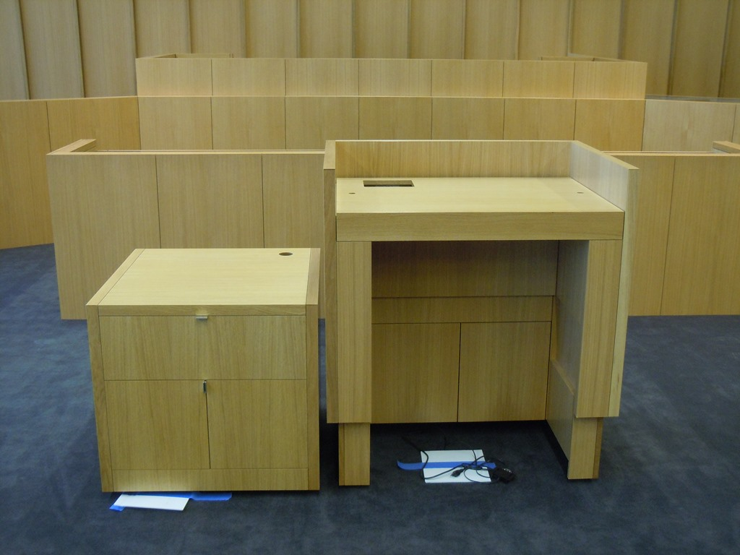

Slide 36
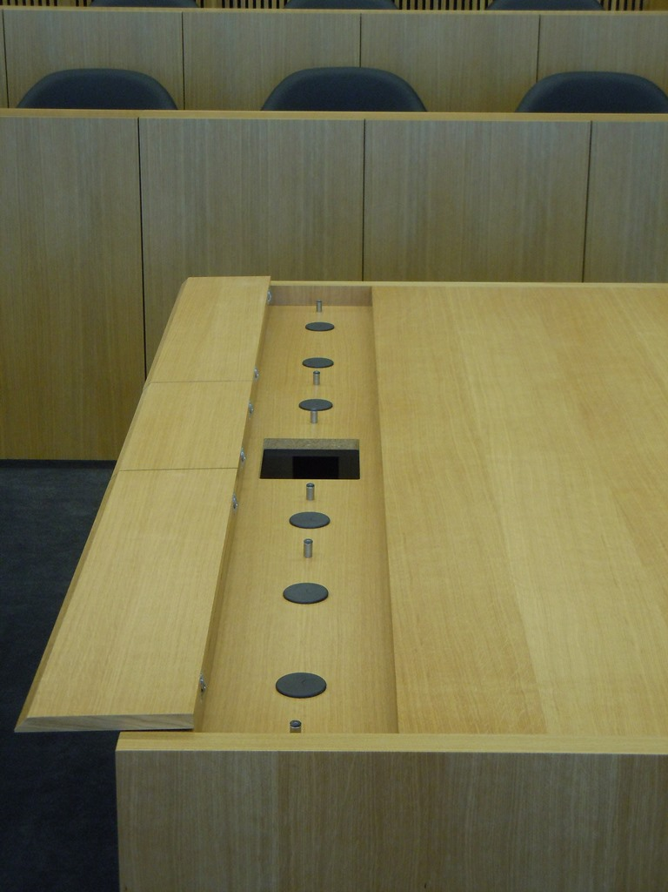

Slide 37
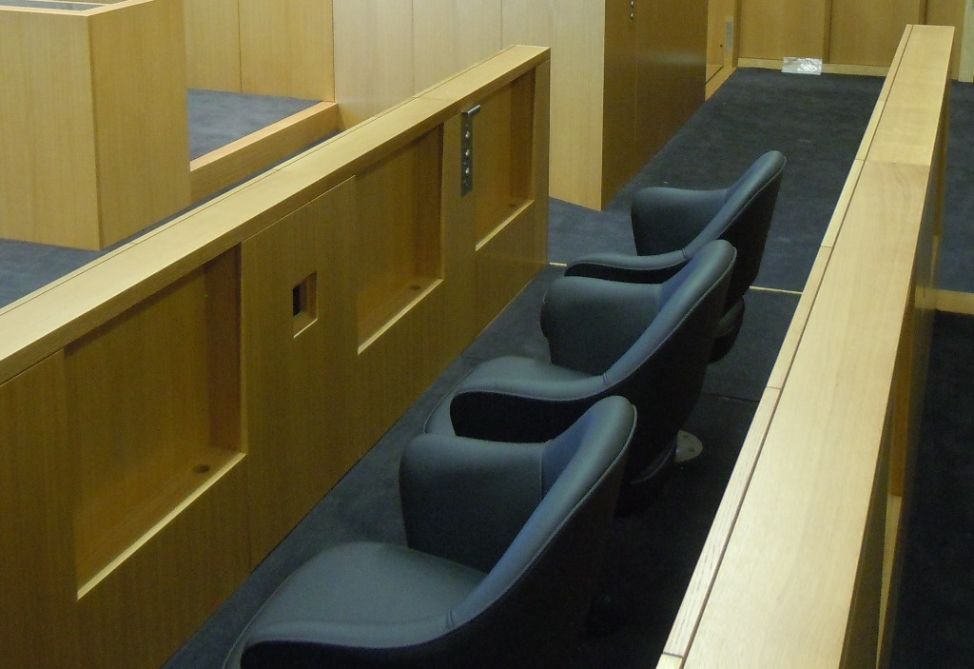

Slide 39
Technology at Trial
3. Use a trial presentation assistant

Slide 40
Technology at Trial
4. Rehearse with a script with exhibit numbers

Slide 41
Technology at Trial
5. Consider using Acrobat for exhibit presentation

Slide 42
Technology at Trial
Use effective deposition presentation
Reader
Video with text

Slide 43
Don’t forget all the other things you normally do SO WELL!
Reminder:

Slide 44
Using Technology to Convince -- And Not Distract -- a Judge and Jury
Utah Federal Bar
Salt Lake City
April 18, 2013
This PowerPoint presentation and the accompanying handout are both found at http://www.utd.uscourts.gov/judges/nuffer_resources.htm#Continuing

